Slide 1
Blood Atlas paper
Title: Atlas of the cells and proteins in human blood
Target journal: Science
Results (synopsis):
Single cell type analysis of human blood cells (Linn, Max)
Genome-wide classification of expression in human blood cell type (Linn, Max)
The human blood cell type restricted genes – comparative analysis of blood cells (Linn, Max)
Body-wide classification based on expression (including blood and extended brain regions) (Linn, Max)
The tissue-restricted genes in human tissues and organs (Linn, Max)
Analysis of human blood using mass cytometry – immuno-validation of new blood markers (Petter)
Mapping the human proteins in blood (Björn)

Slide 2
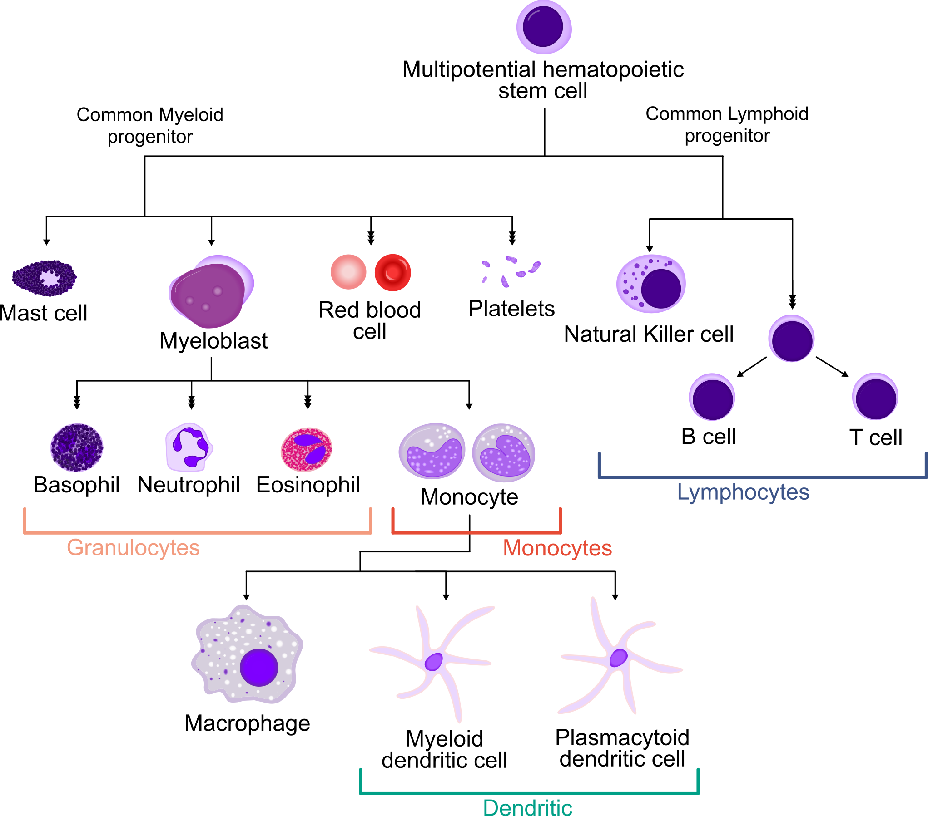
Fig. 1A
(chapter 1)

Slide 3
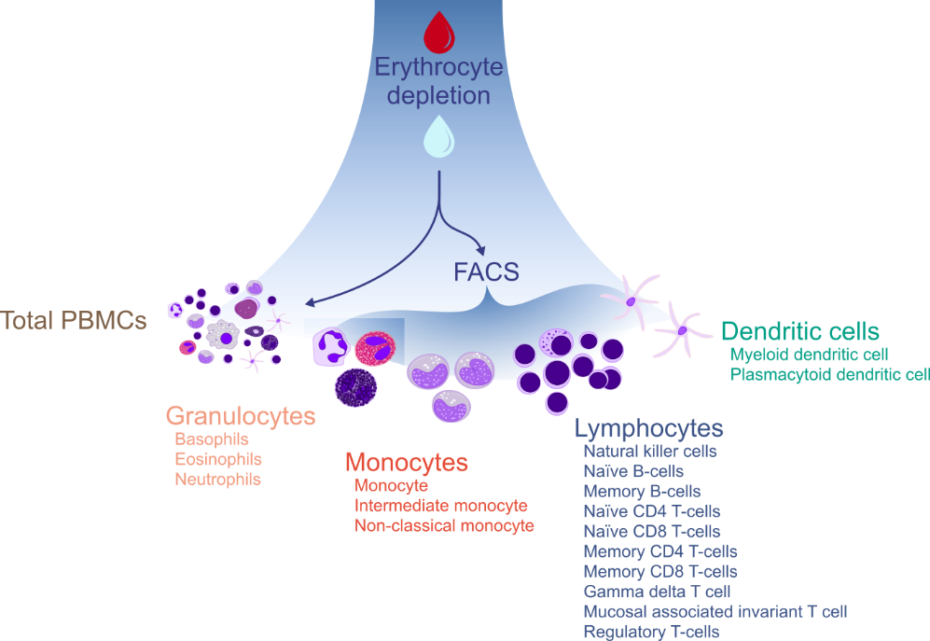

Slide 4
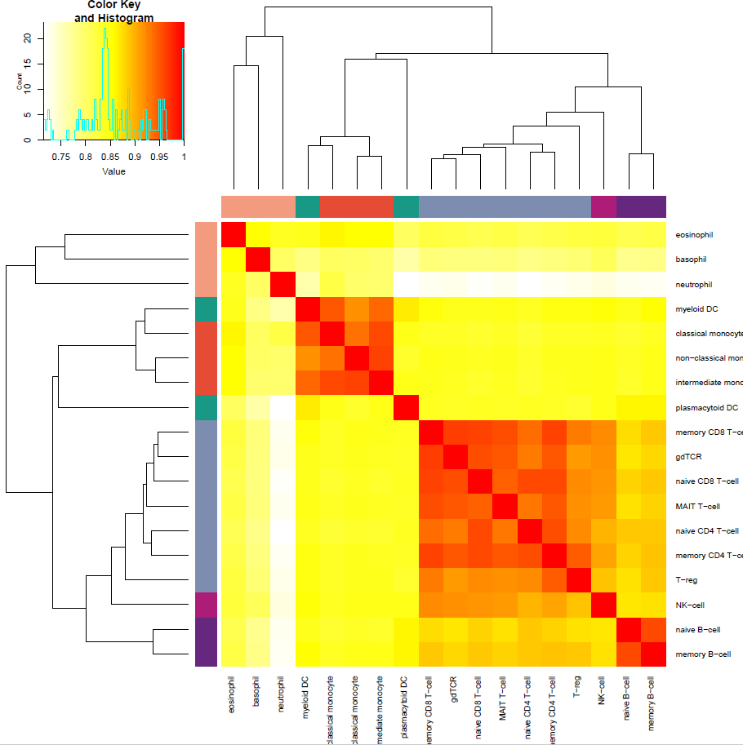
Fig. 1B
(chapter 1)

Slide 5
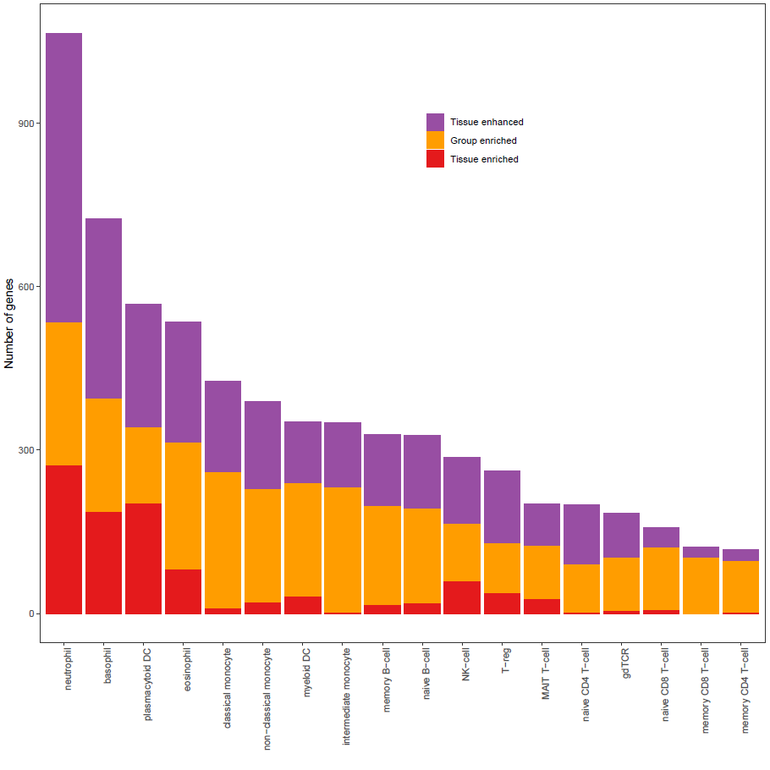
Fig. 1C
(chapter 2)

Slide 6
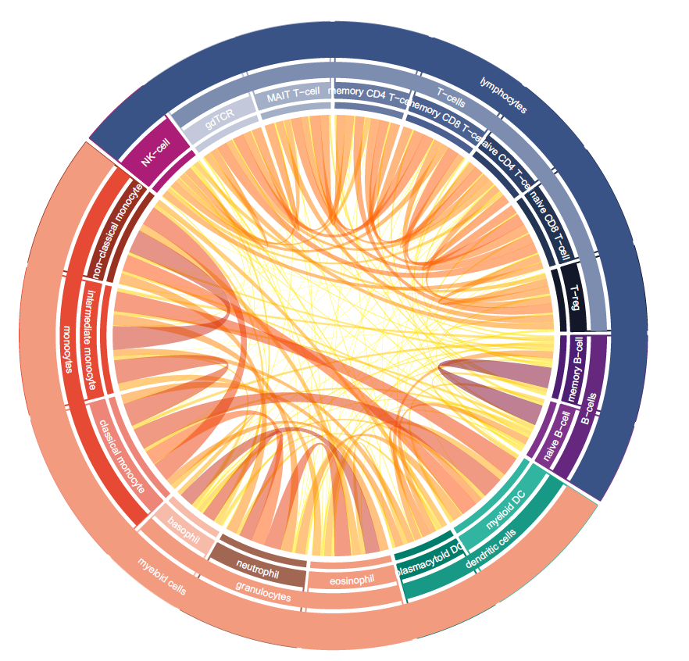
Fig. 1Da
(chapter 2)

Slide 7
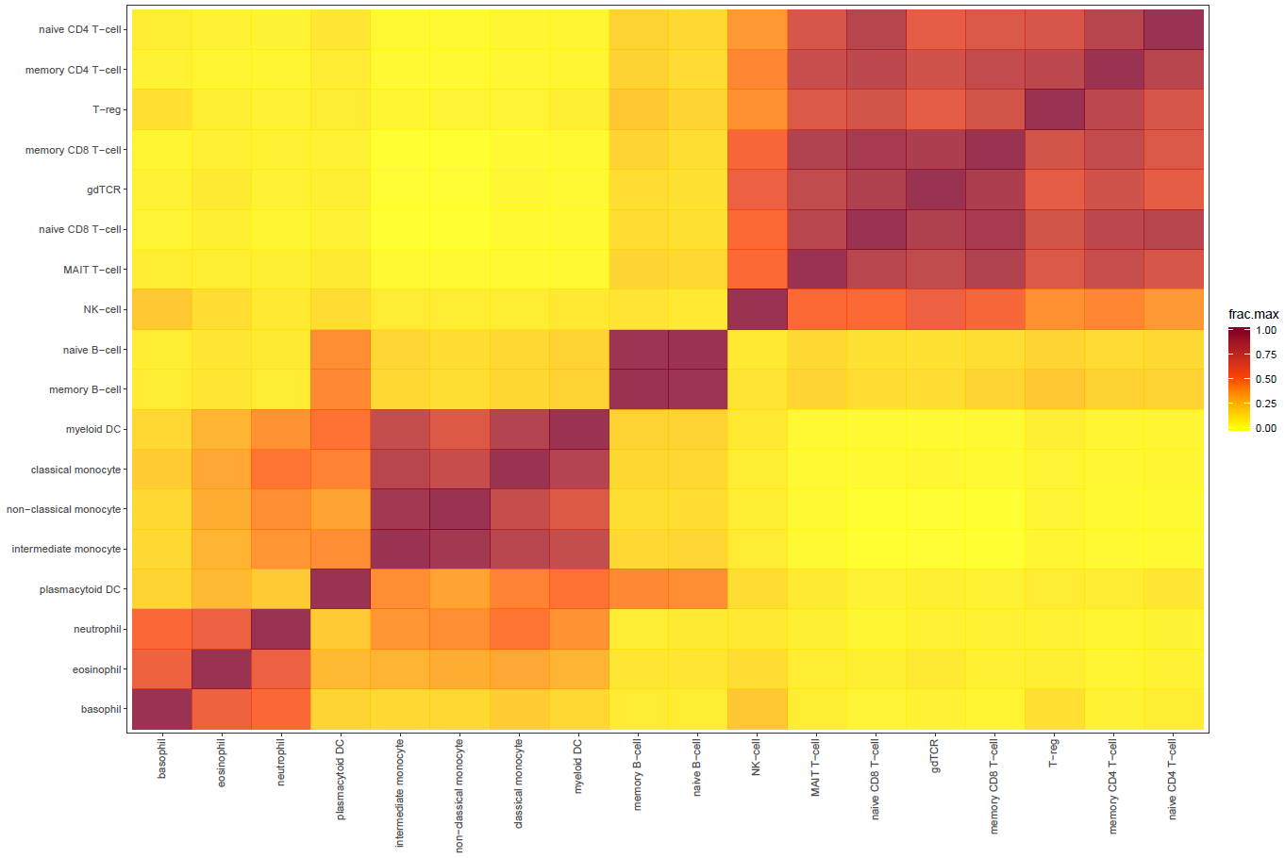
Fig. 1Db
(chapter 2)

Slide 8
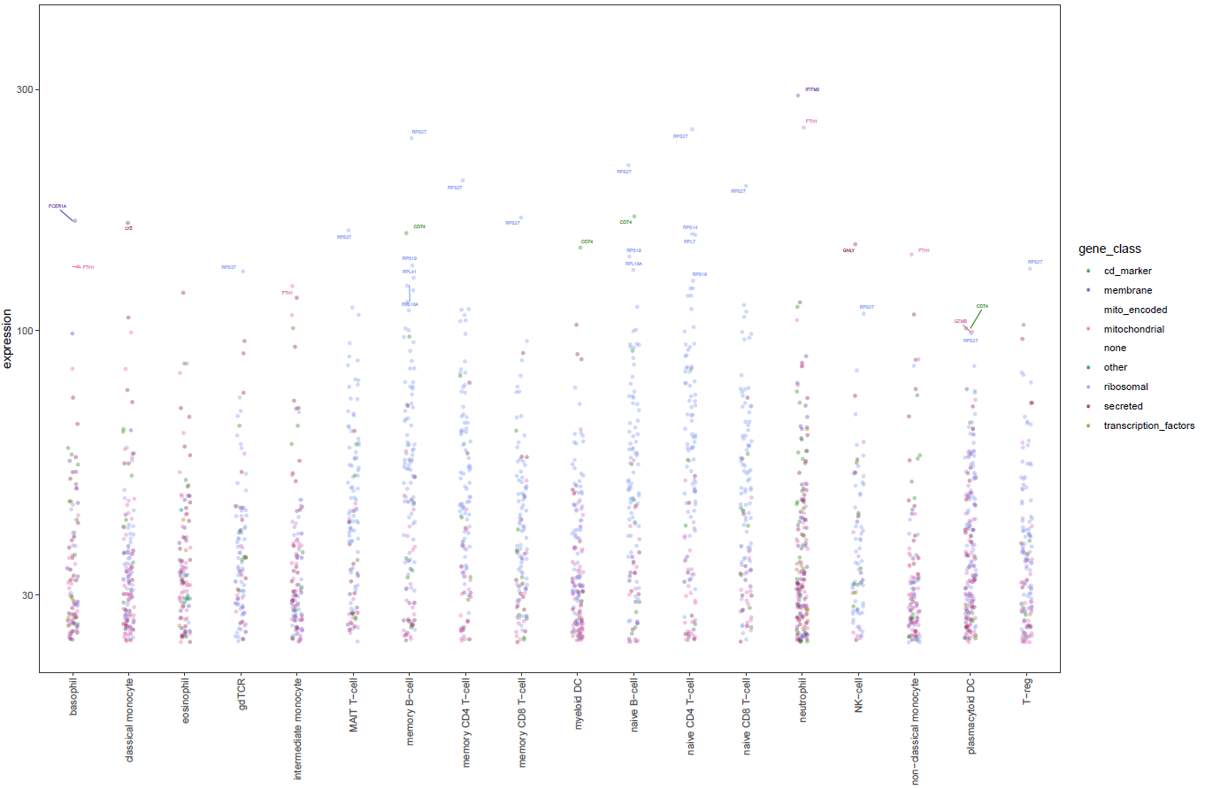
Fig. 1E
(chapter 3)

Slide 9
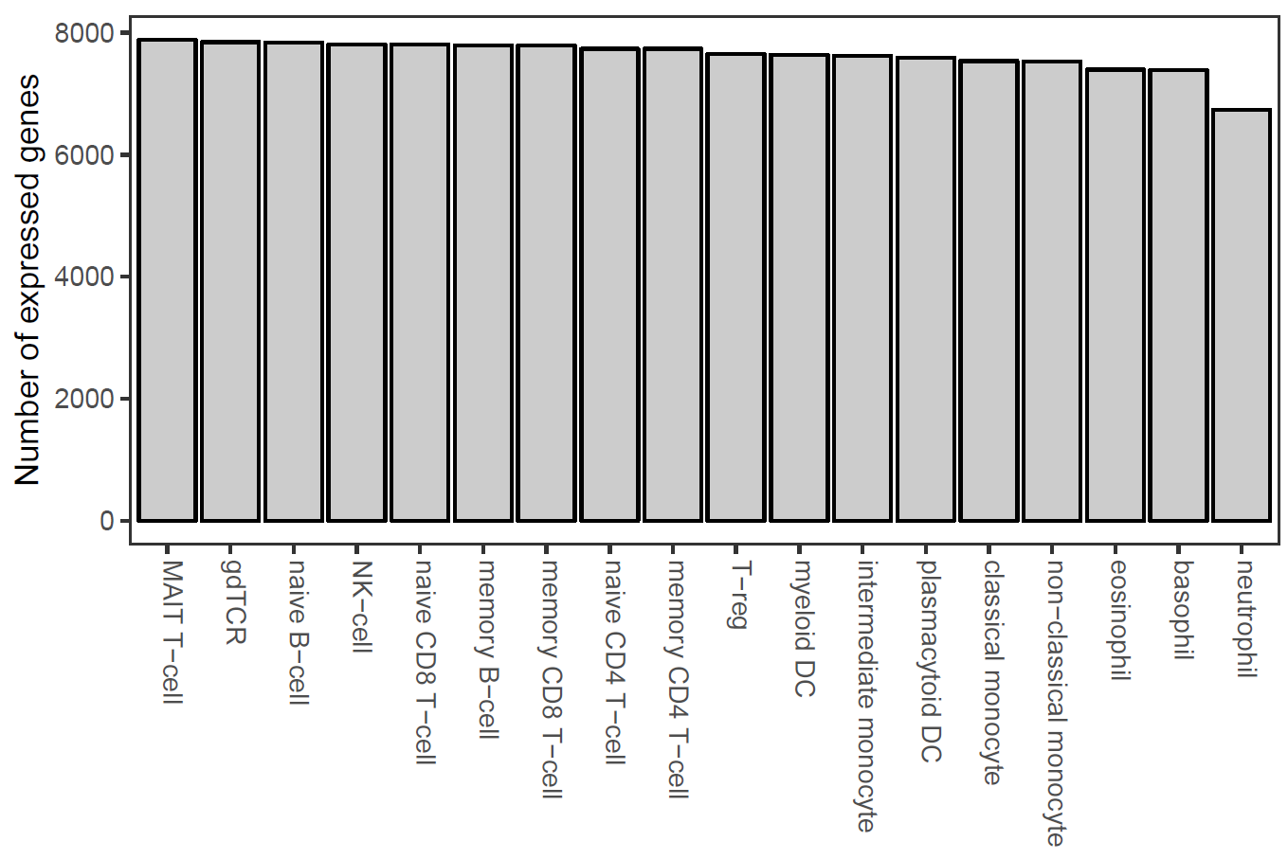
Fig. 1F
(chapter 3)

Slide 10
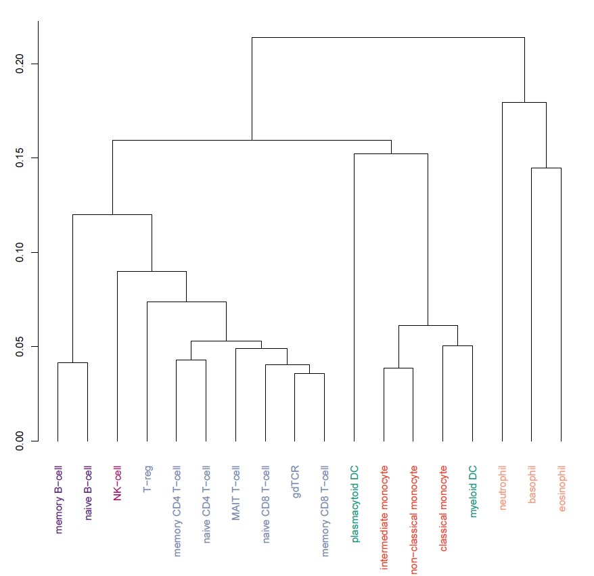
Fig. 1G
(chapter 2)

Slide 11
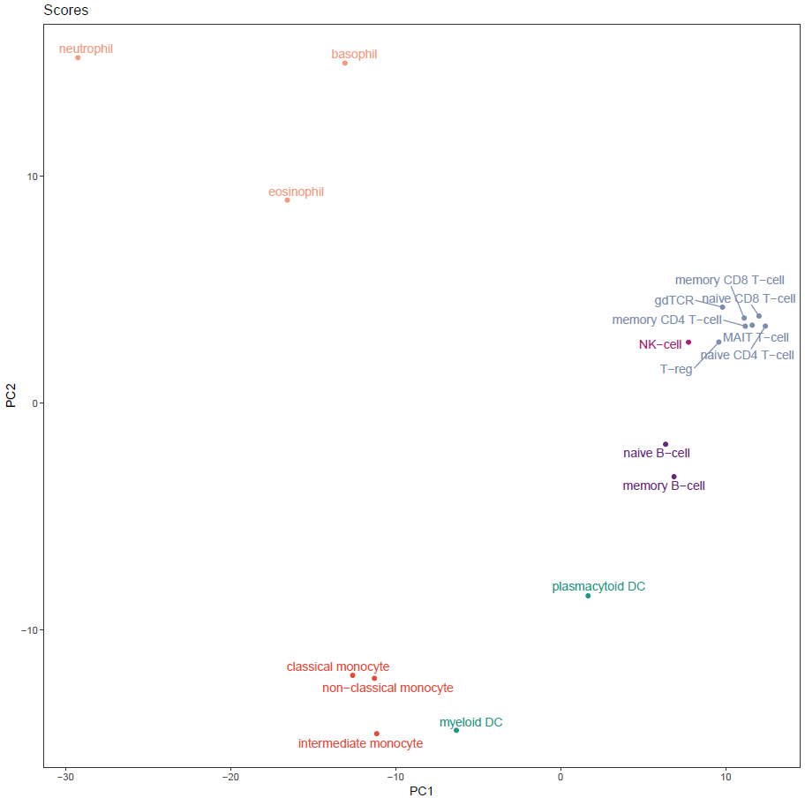
Fig. 1H
(chapter 2)

Slide 12
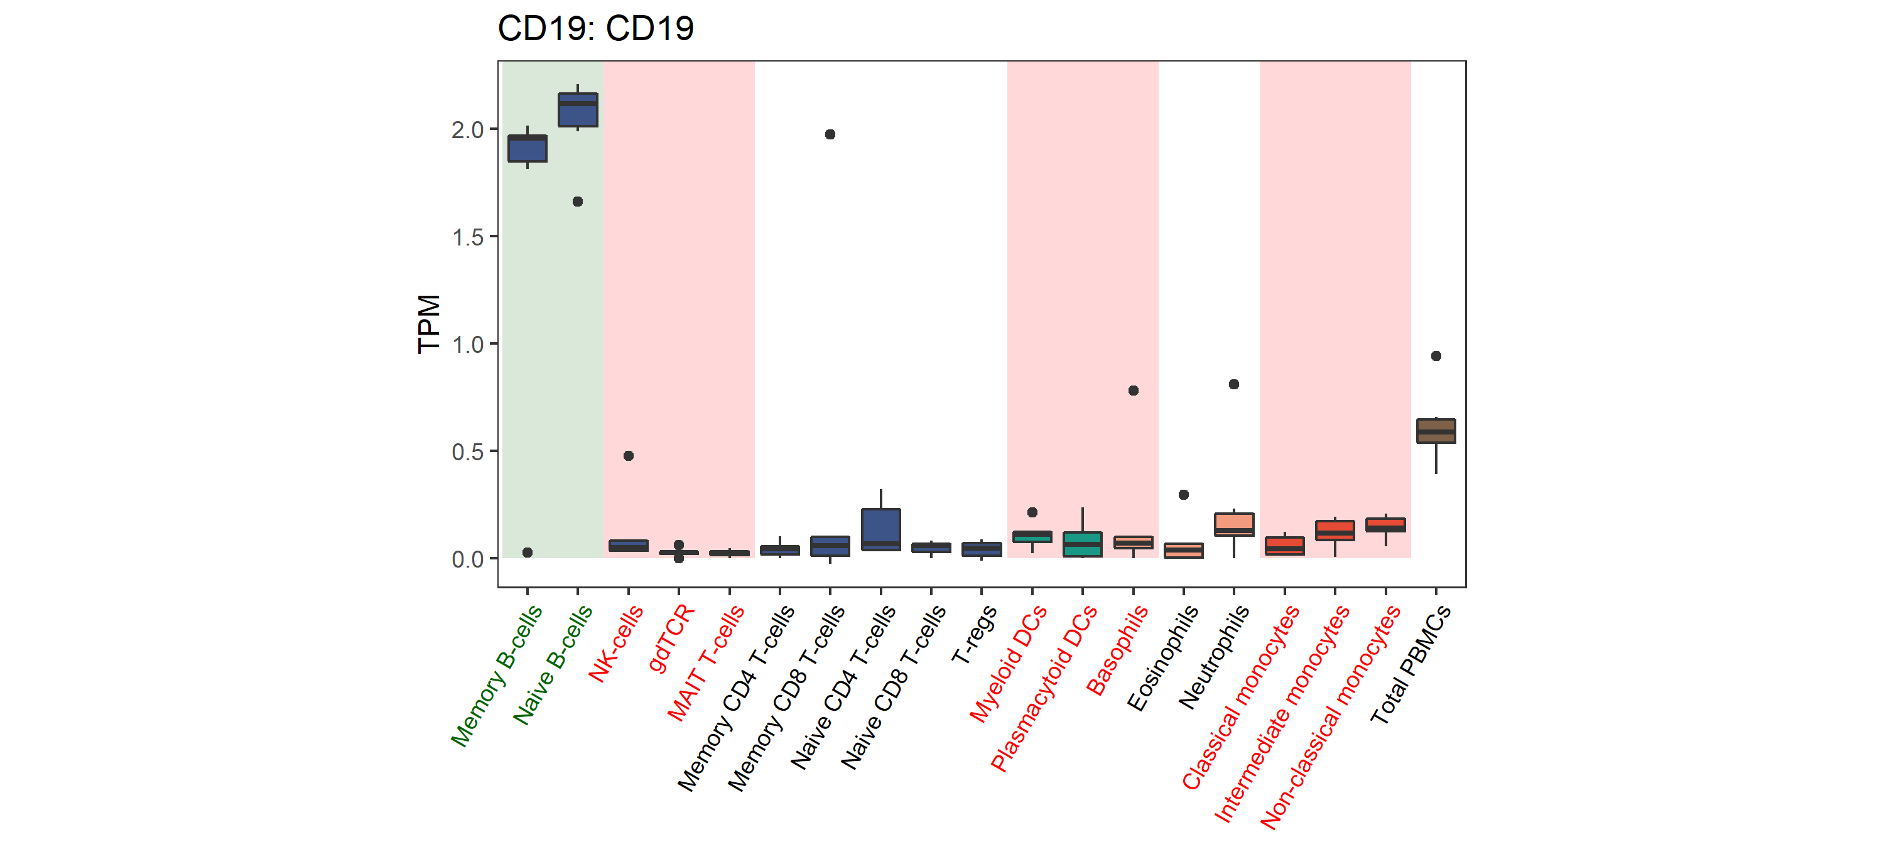
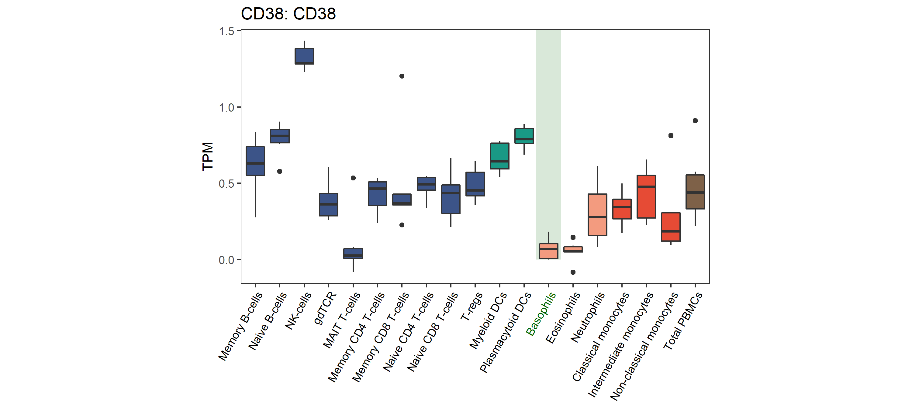
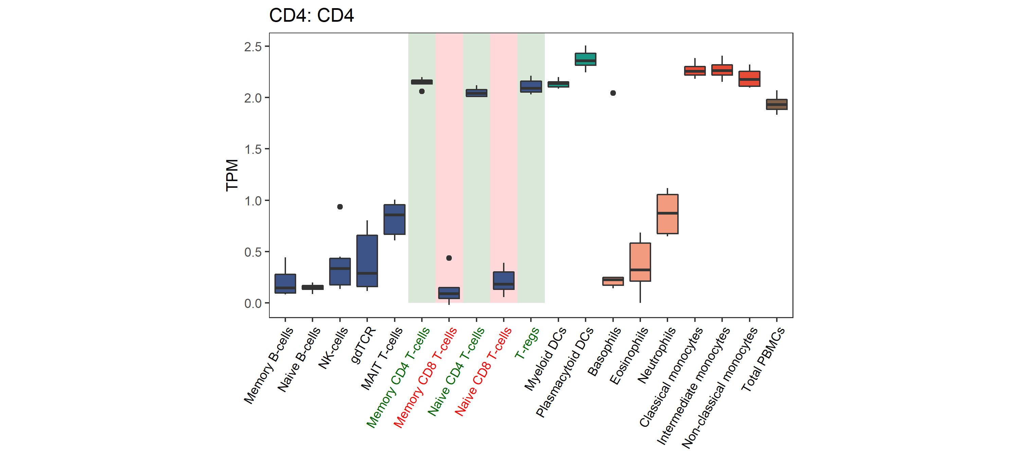
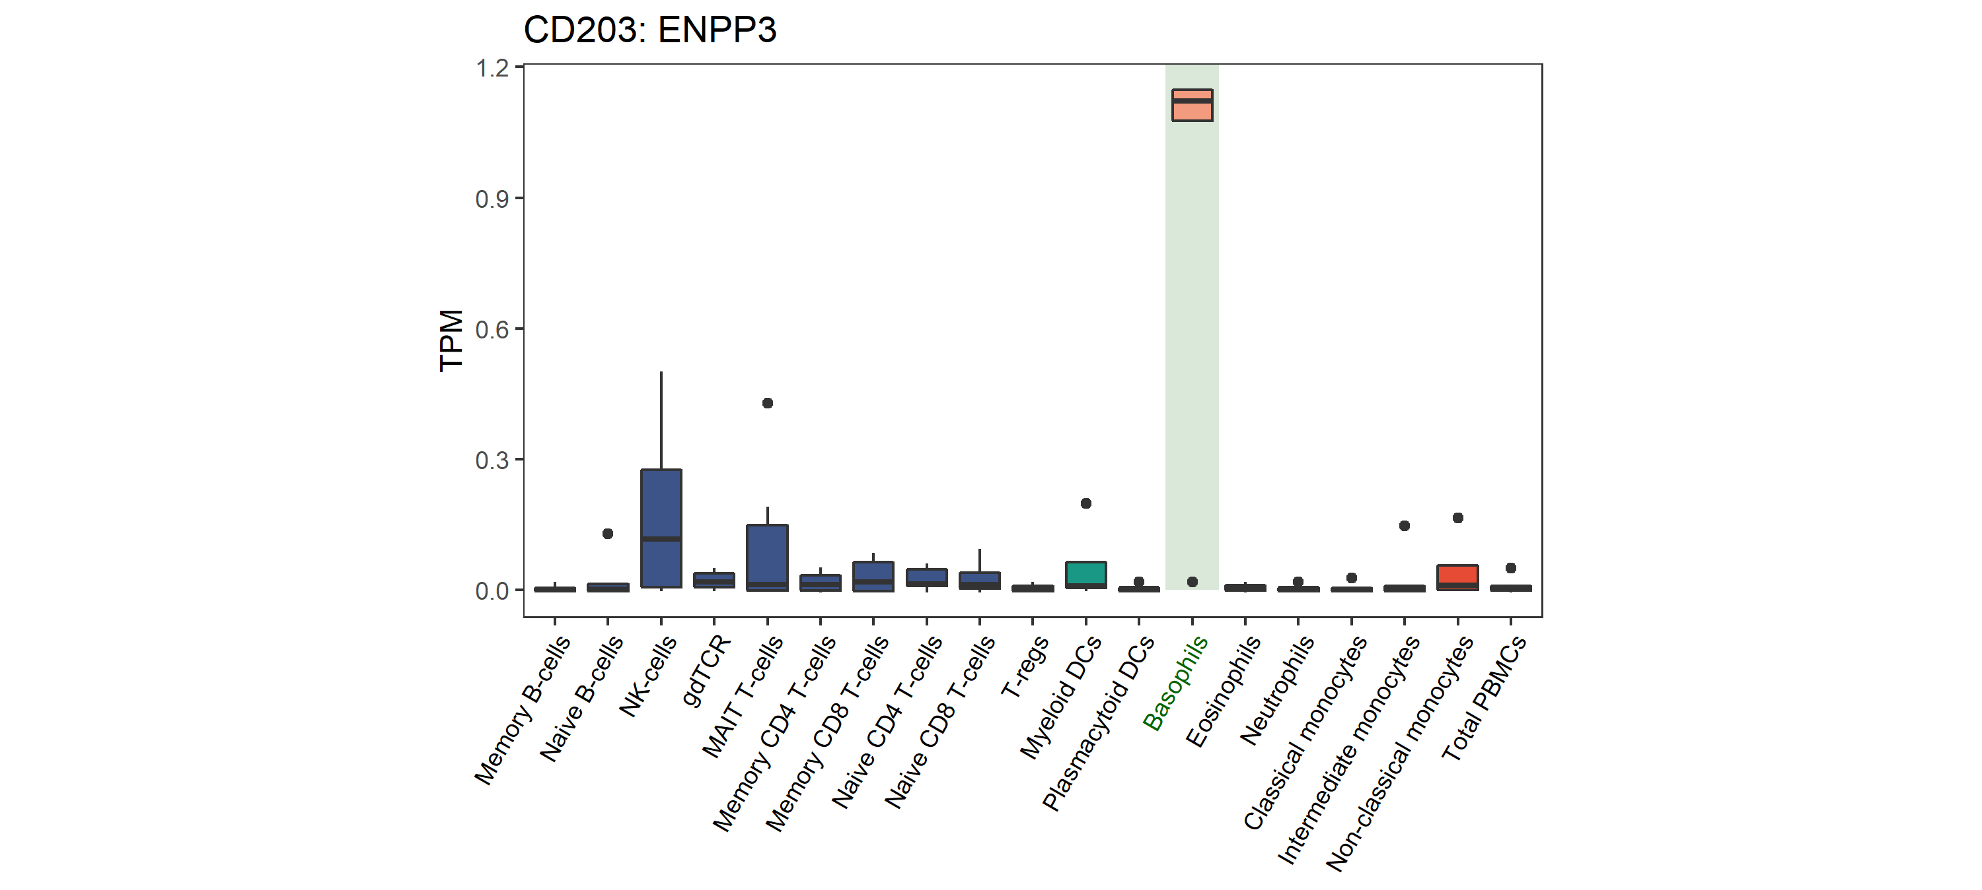
Fig. 1I
(chapter 2)

Slide 13
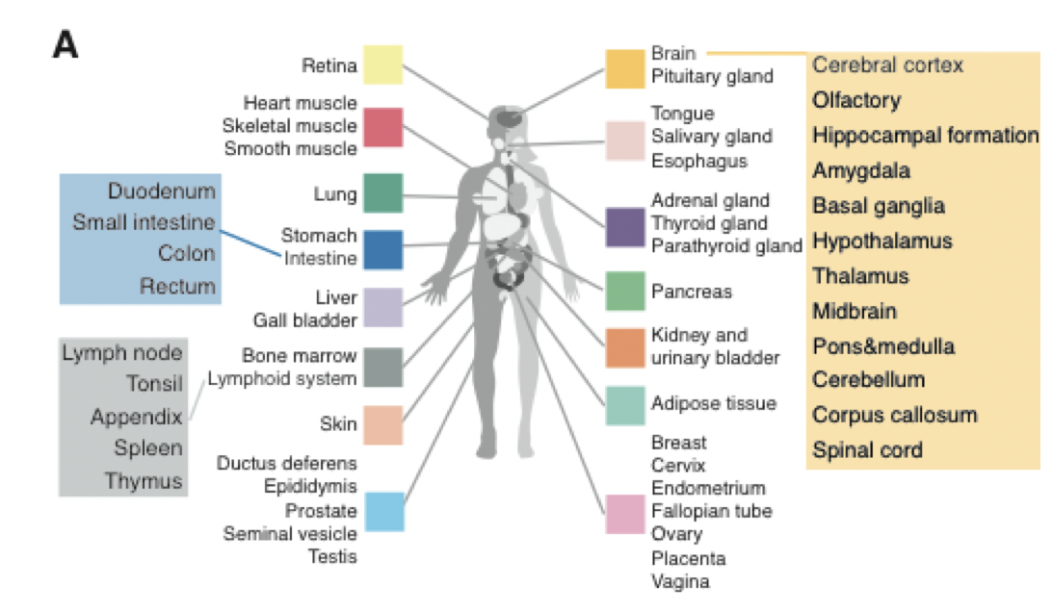
Fig. 2A
(chapter 4)

Slide 14
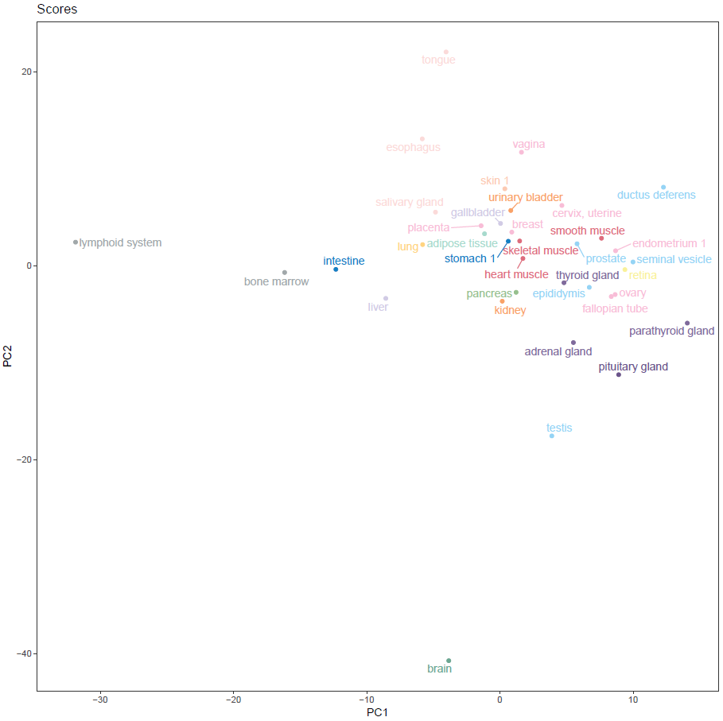
Fig. 2B
(chapter 4)

Slide 15
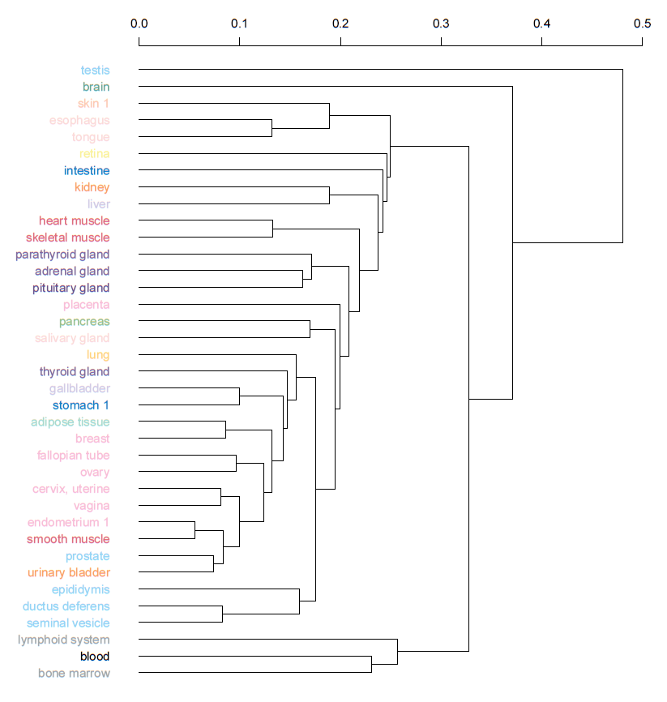
Fig. 2C
(chapter 4)

Slide 16
Fig. 2E
(chapter 4)
Tissue distribution
Tissue specificity | Single | In some | In many | In all | Not detected | Total
Tissue enriched | 599 | 1114 | 480 | 72 | 0 | 2265
Group enriched | 0 | 921 | 348 | 30 | 0 | 1299
Tissue enhanced | 94 | 1312 | 3182 | 912 | 0 | 5500
Low tissue specificity | 19 | 83 | 2201 | 8186 | 0 | 10489
Not detected | 0 | 0 | 0 | 0 | 117 | 117
Grand Total | 712 | 3430 | 6211 | 9200 | 117 | 19670

Slide 17
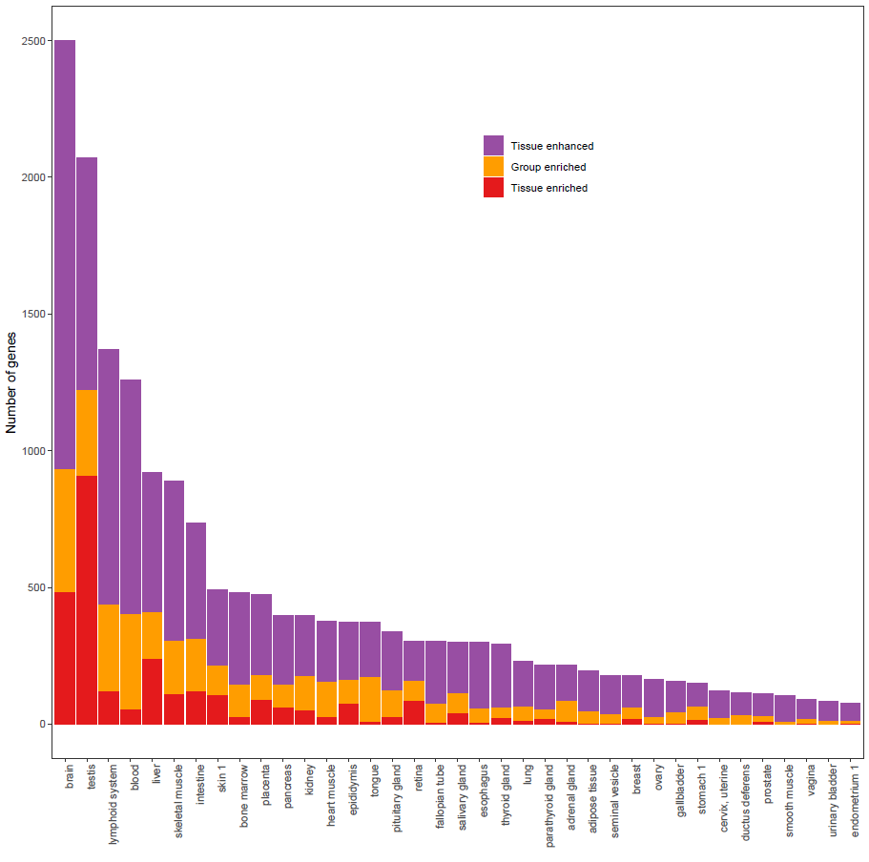
Fig. 2D
(chapter 5)

Slide 18
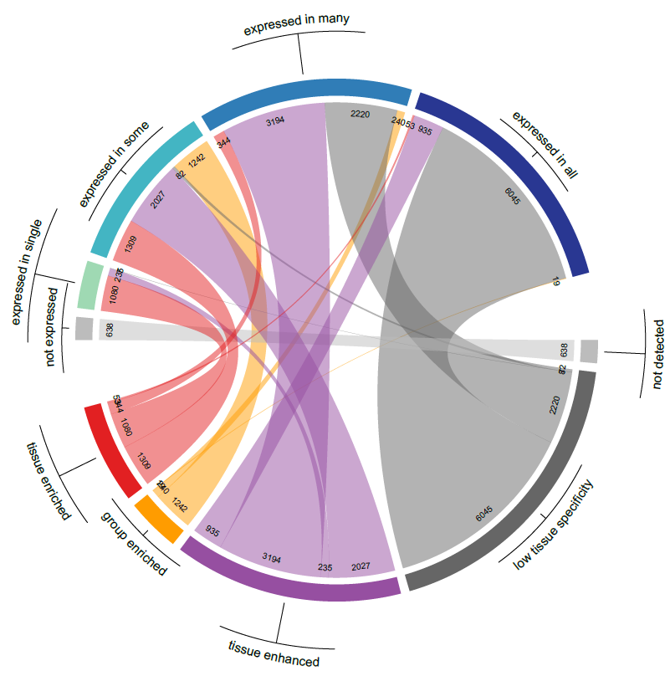
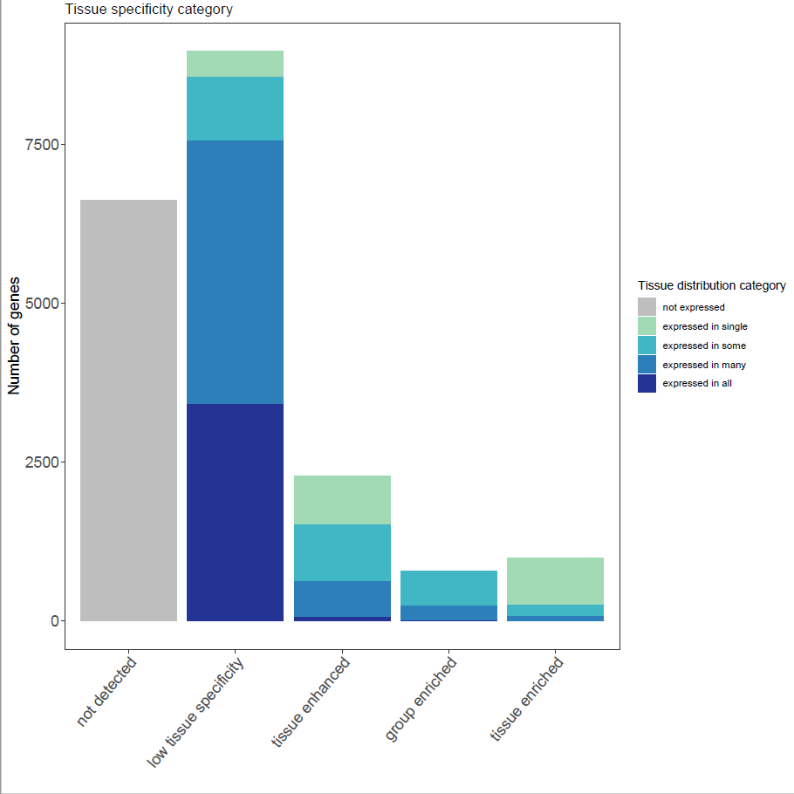
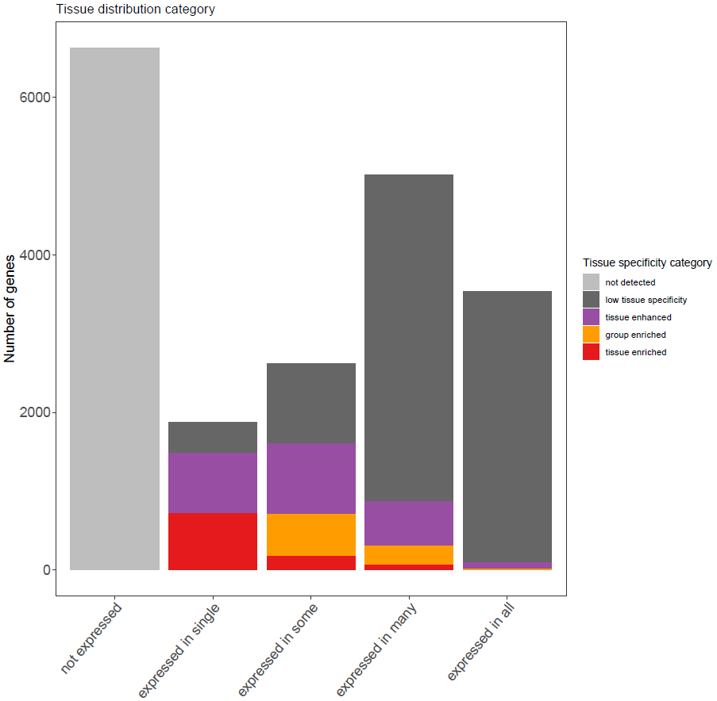
Fig. 2F
(chapter 5)

Slide 19
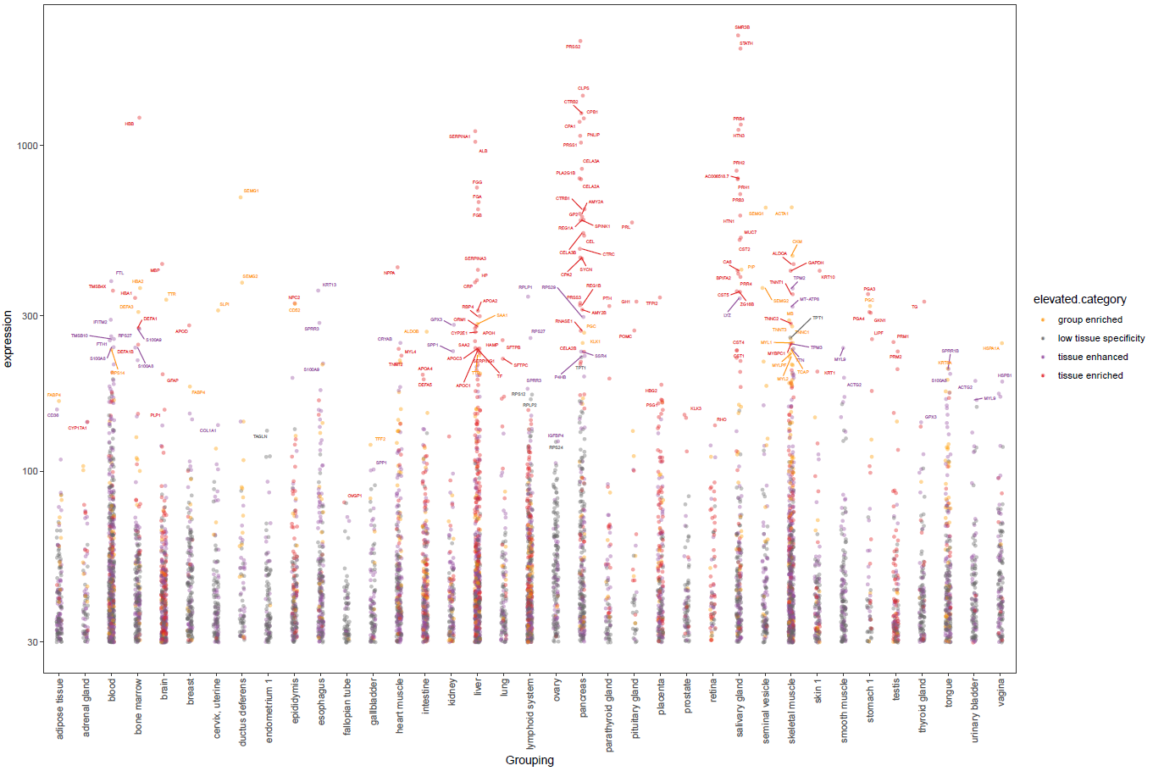
Fig. 2G
(chapter 5)

Slide 20
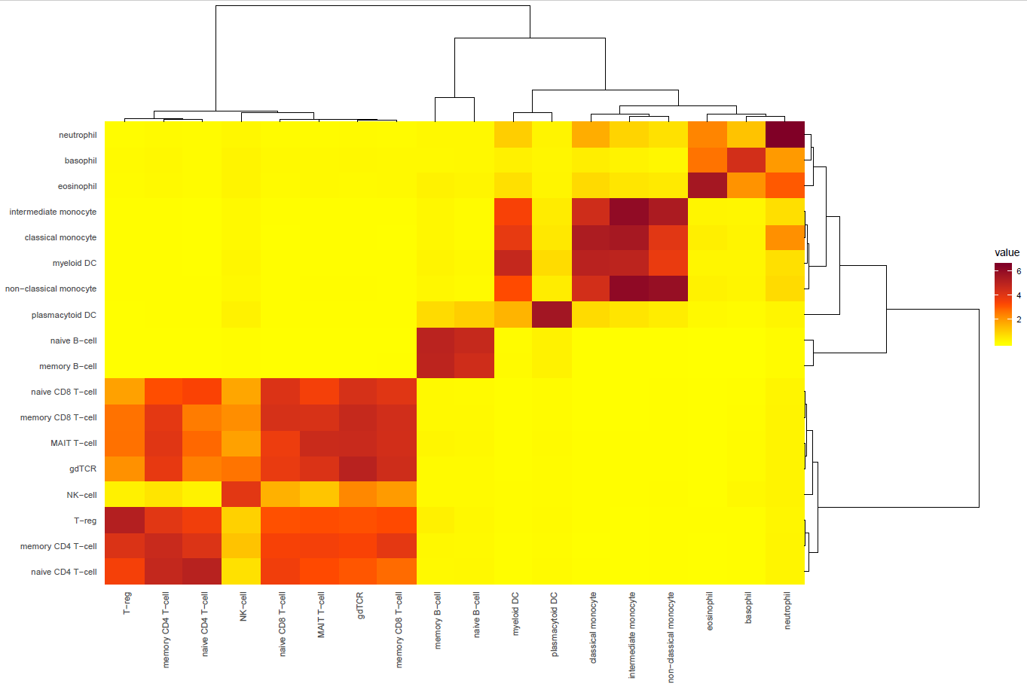
Fig. 2H
(chapter 5)
Median expression of group enriched genes (in x-axis cells) in other cells (in y-axis)

Slide 21
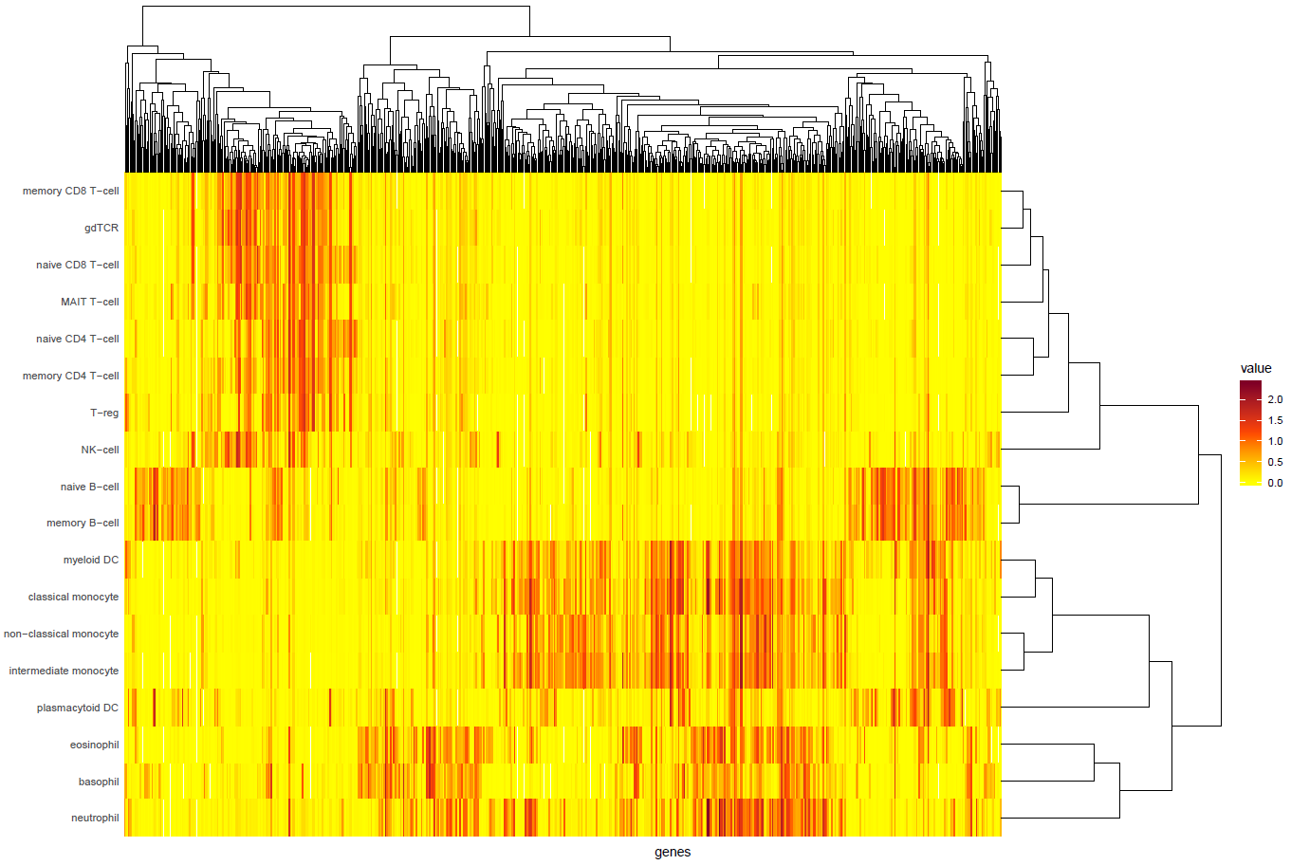
Fig. 2I
(chapter 5)
Expression of group enriched genes

Slide 22
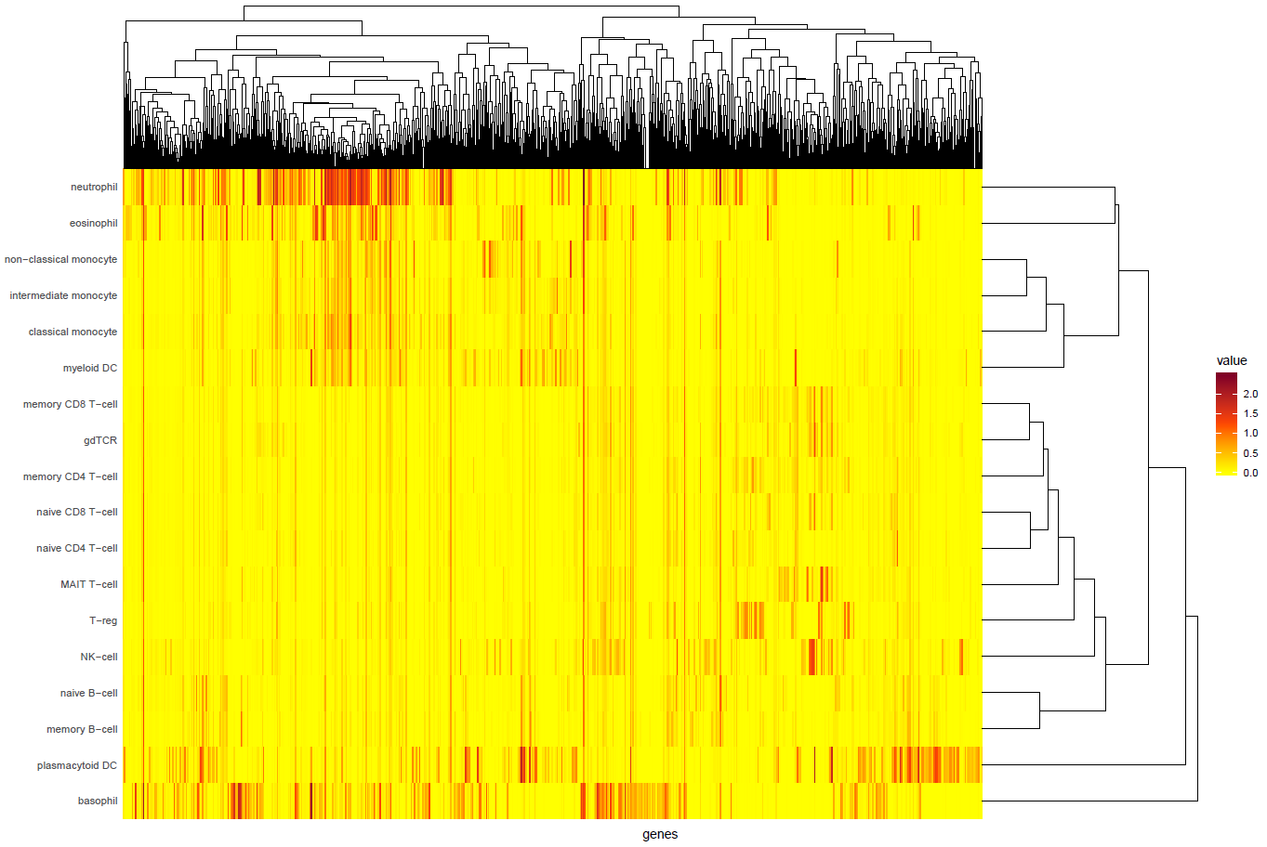
Fig. 2J
(chapter 5)
Expression of tissue enriched genes

Slide 23
Figure 3. Comparison of blood cell type classification and whole body classification
A. Circus plot med elevated genes (3+3)
B. Compare bone marrow + blood + lymphoid tissues
C. Blood differentiation (Dseq etc)

Slide 24
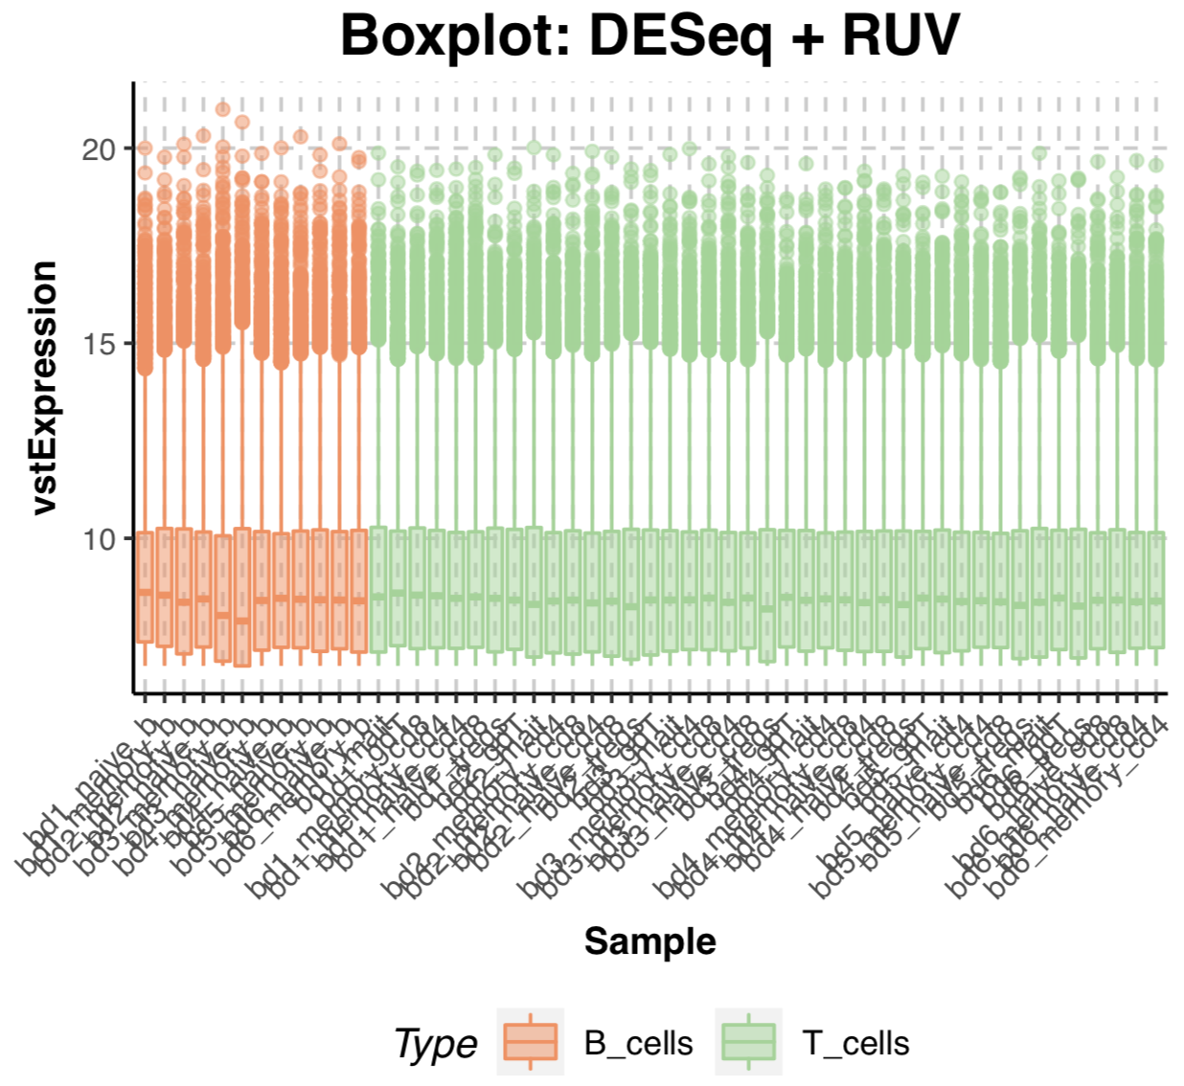
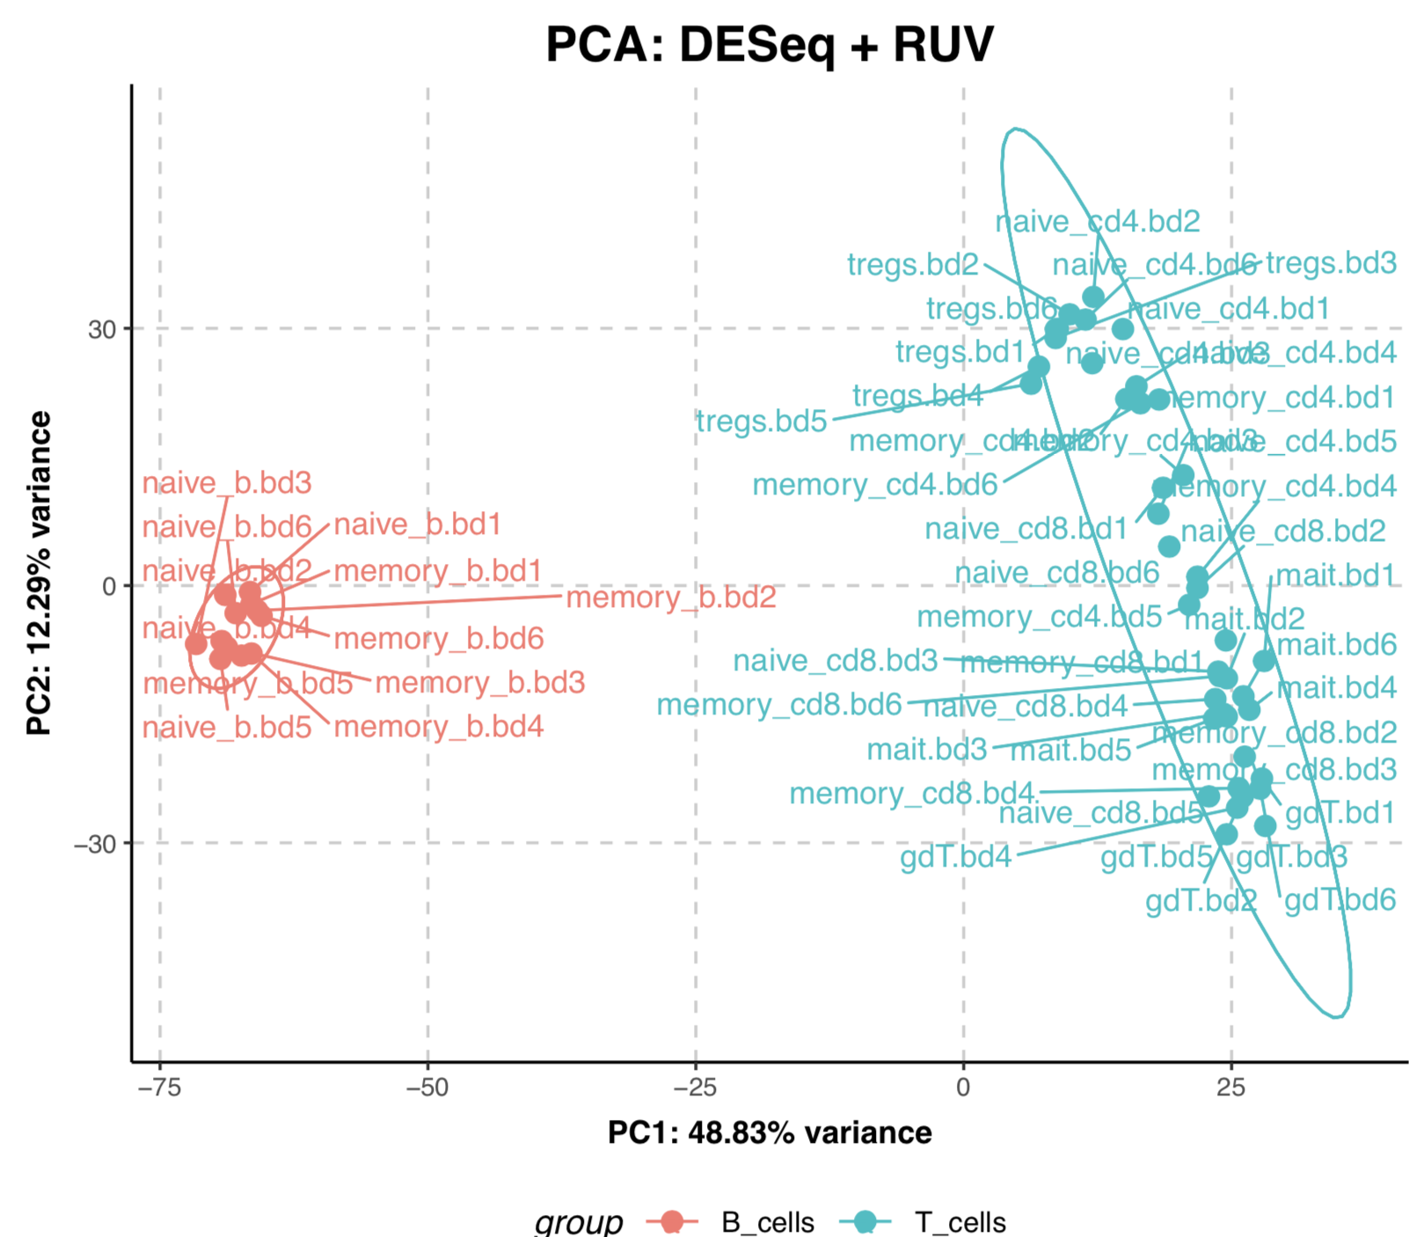
B_cells vs T_cells

Slide 25
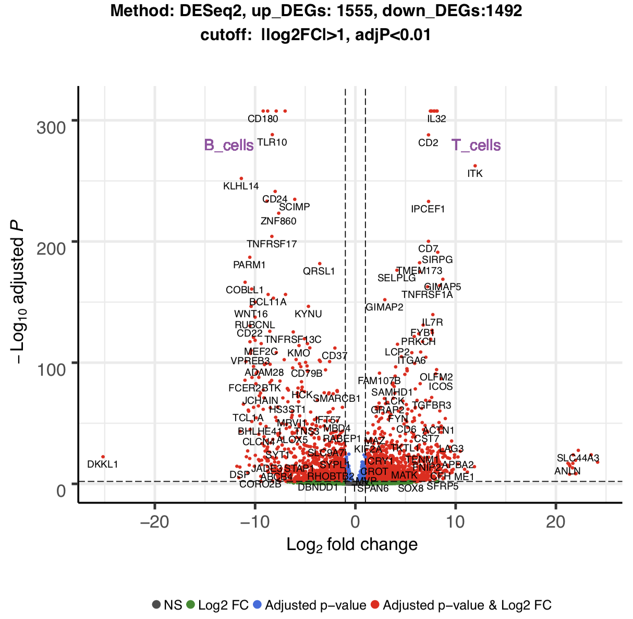
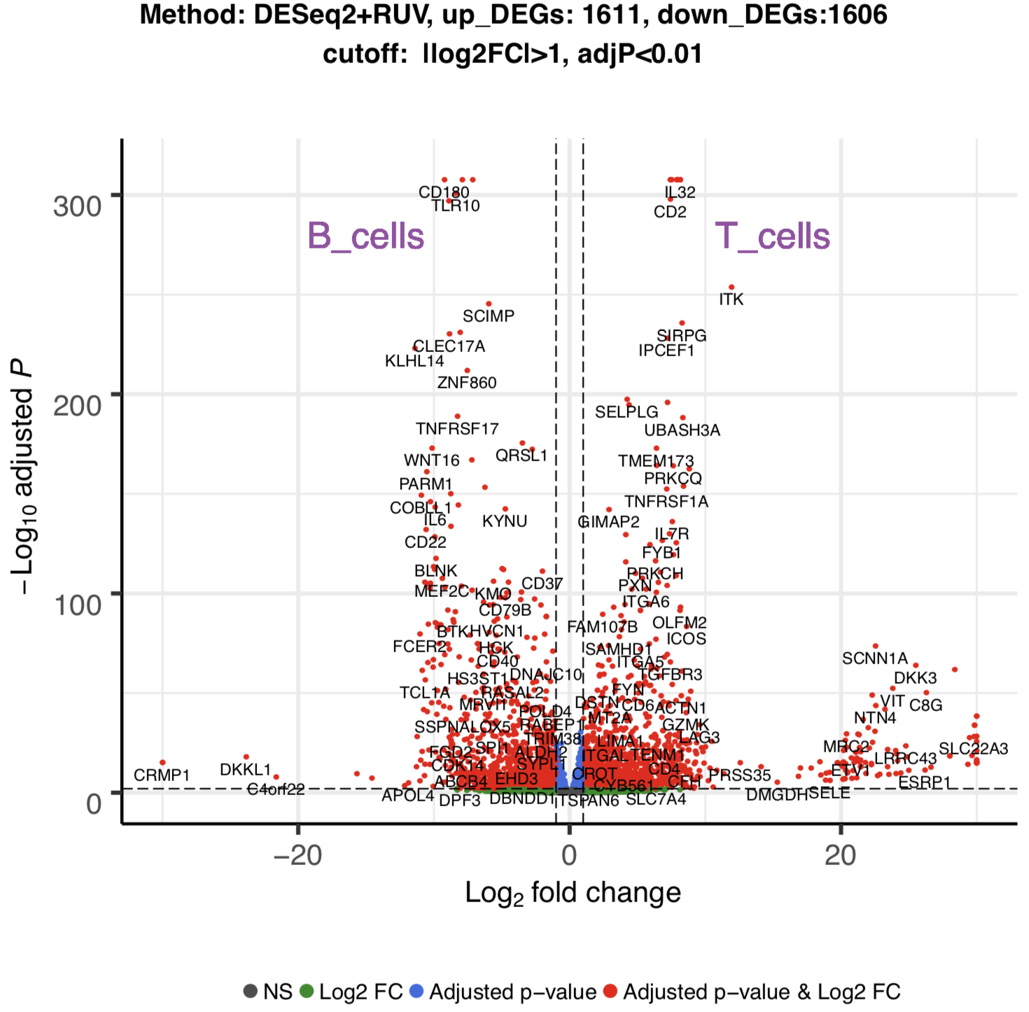
B_cells vs T_cells

Slide 26
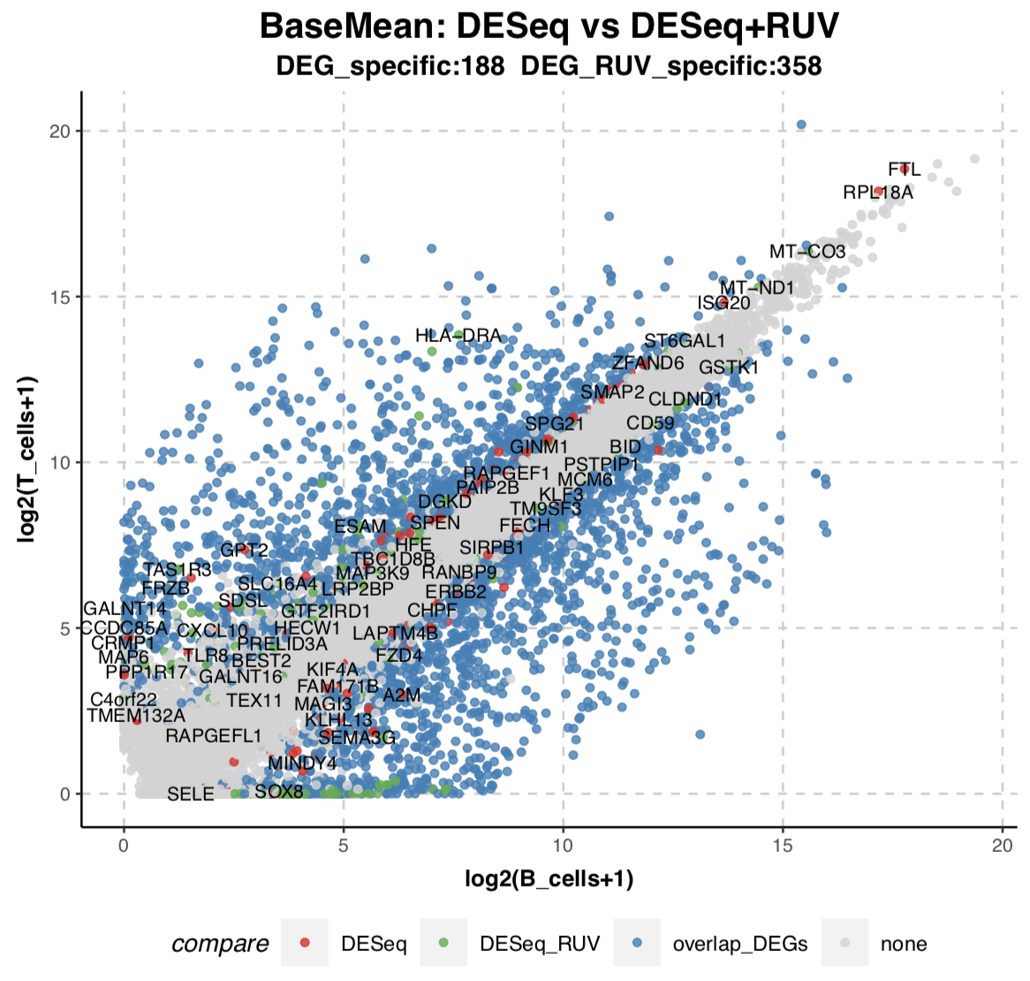
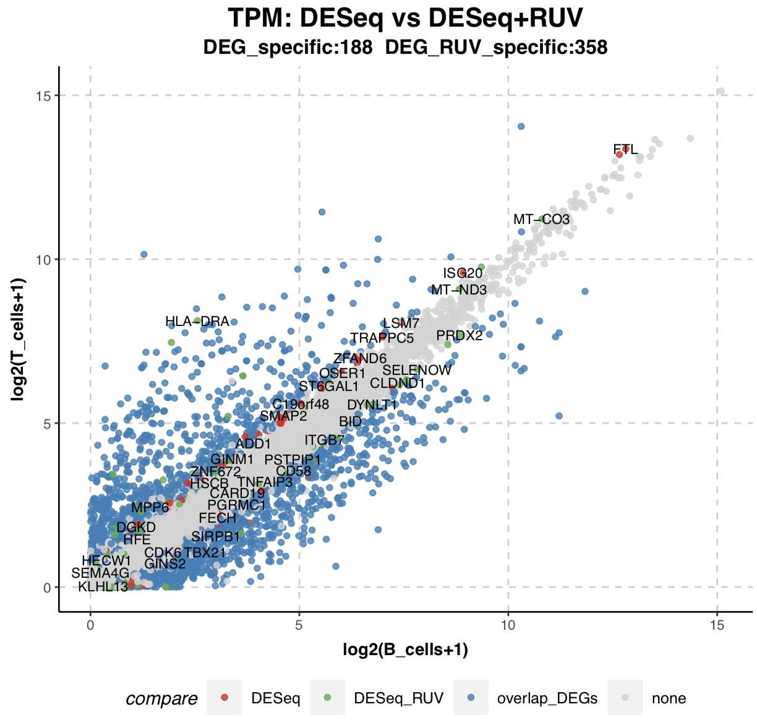
B_cells vs T_cells

Slide 27
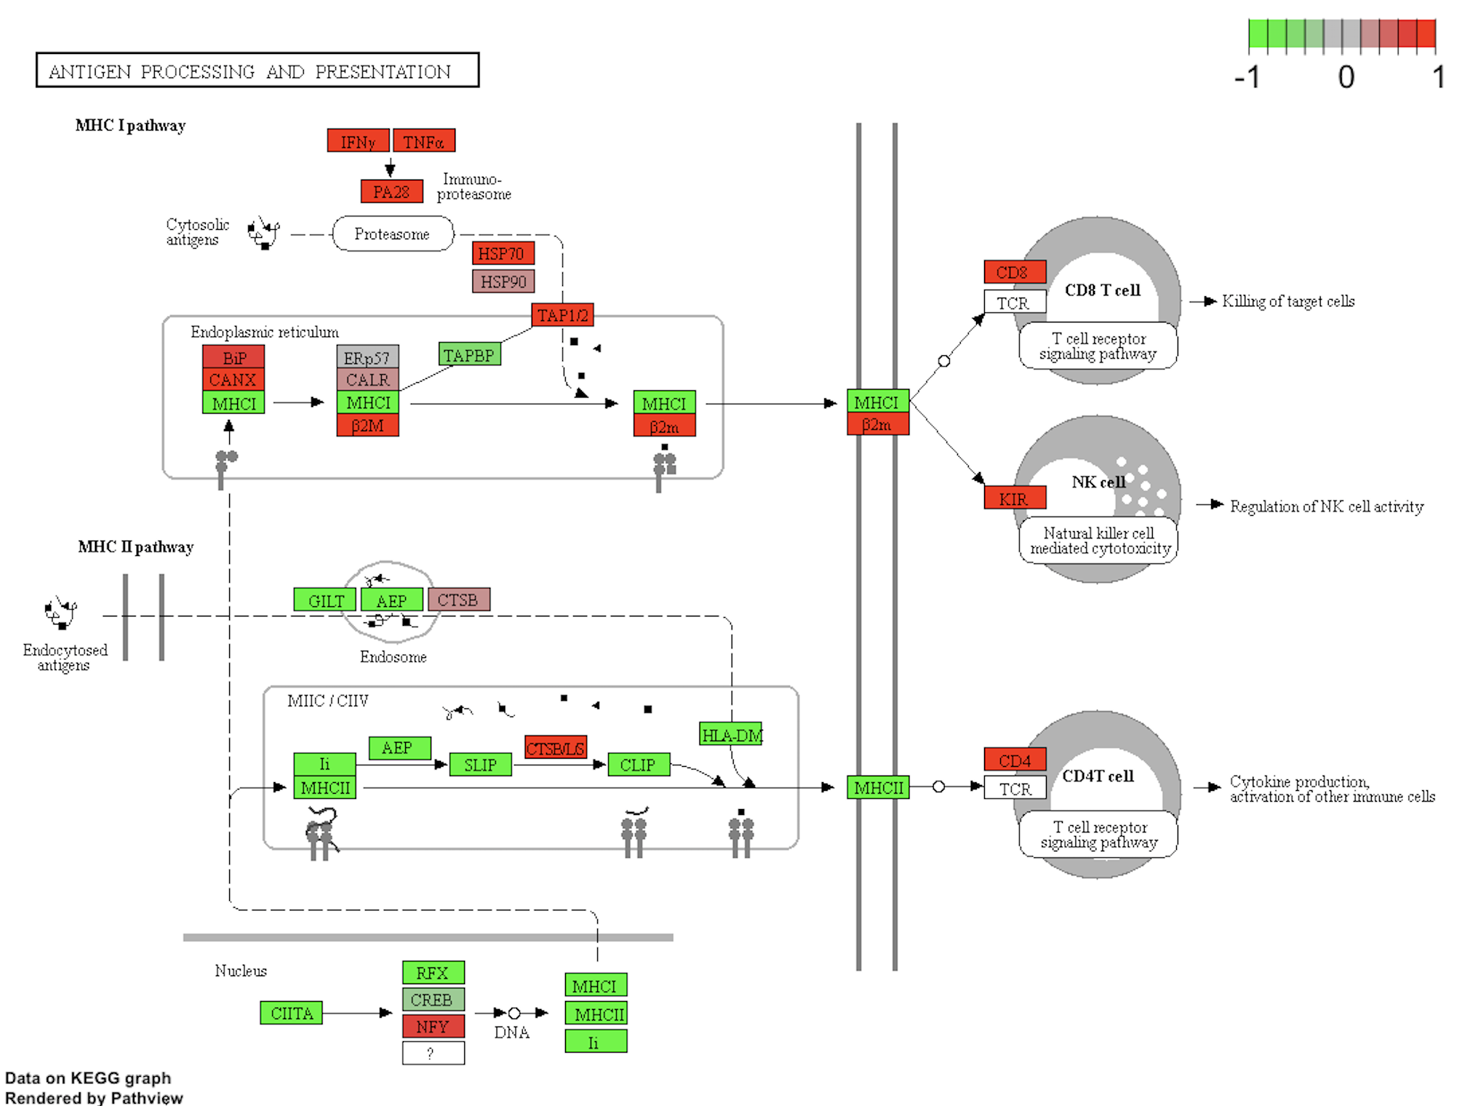
B_cells vs T_cells
GAGE (Generally Applicable Gene-set Enrichment ) anlaysis
One example of sig KEGG pathways from gage

Slide 28
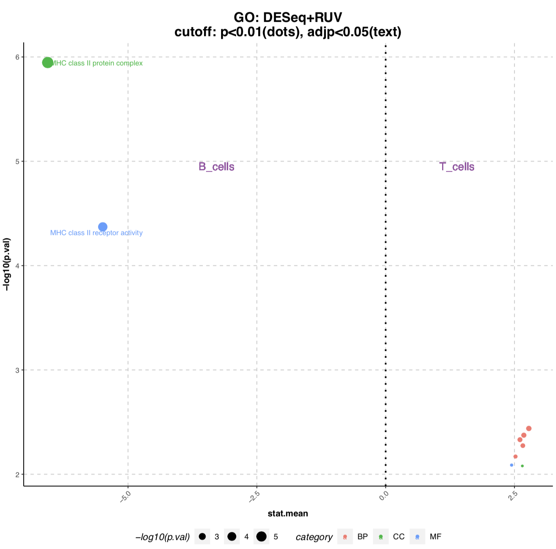
B_cells vs T_cells
GAGE (Generally Applicable Gene-set Enrichment ) anlaysis
GO result from gage

Slide 29
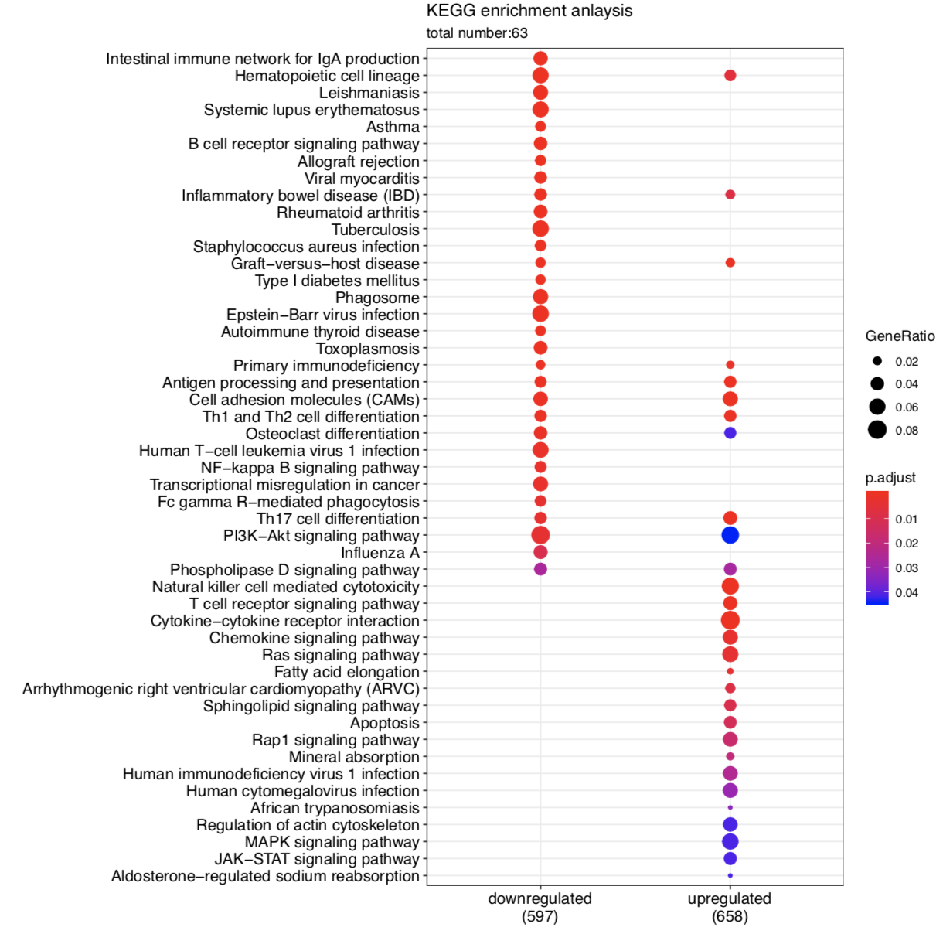
B_cells vs T_cells
DEGs KEGG enrichment anlaysis (top 30)

Slide 30
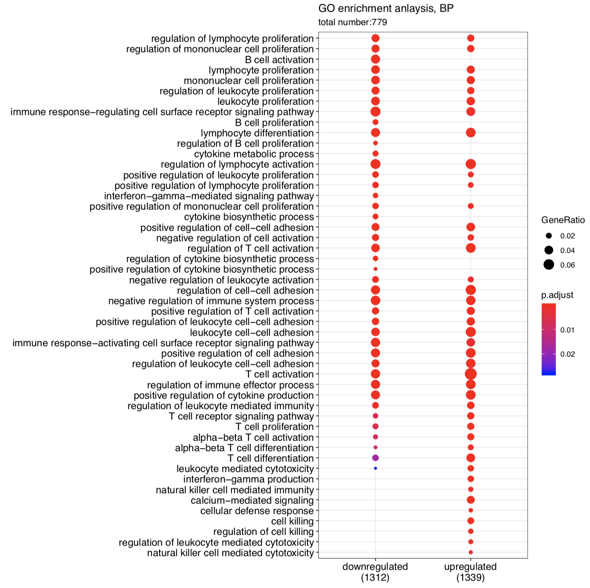
B_cells vs T_cells
DEGs GO (BP/MF/CC) enrichment anlaysis (top 30)

Slide 31
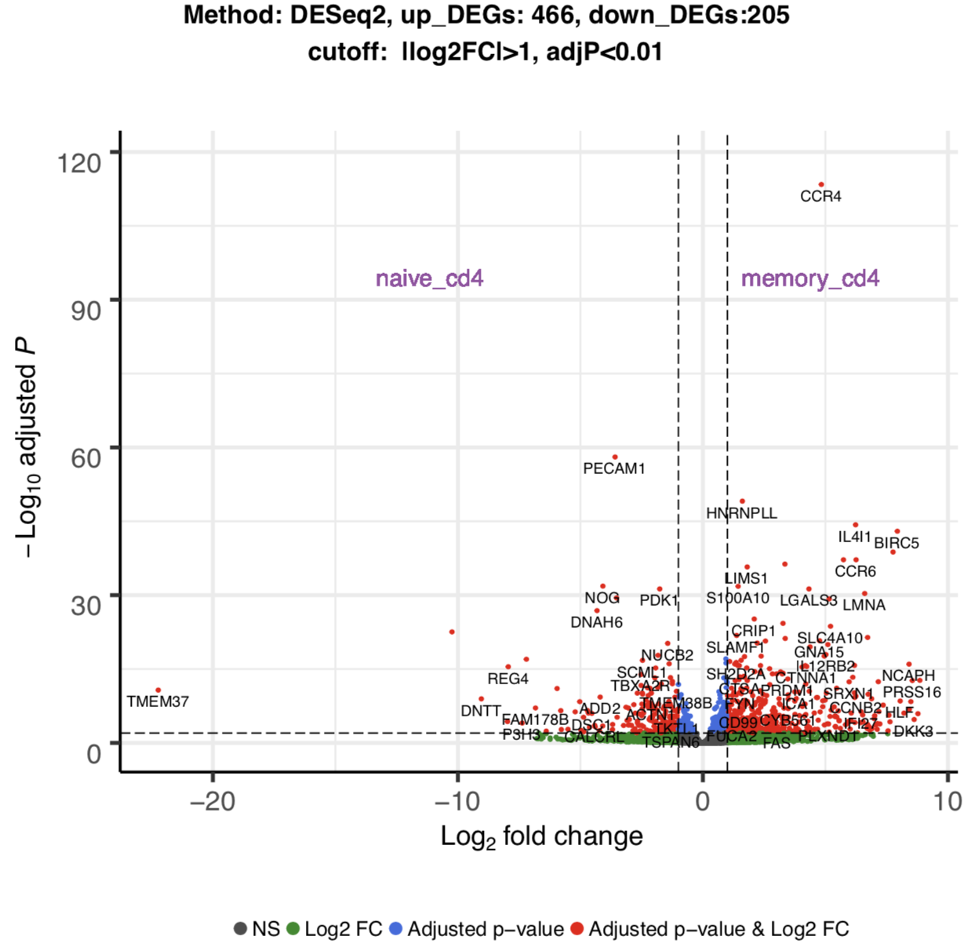
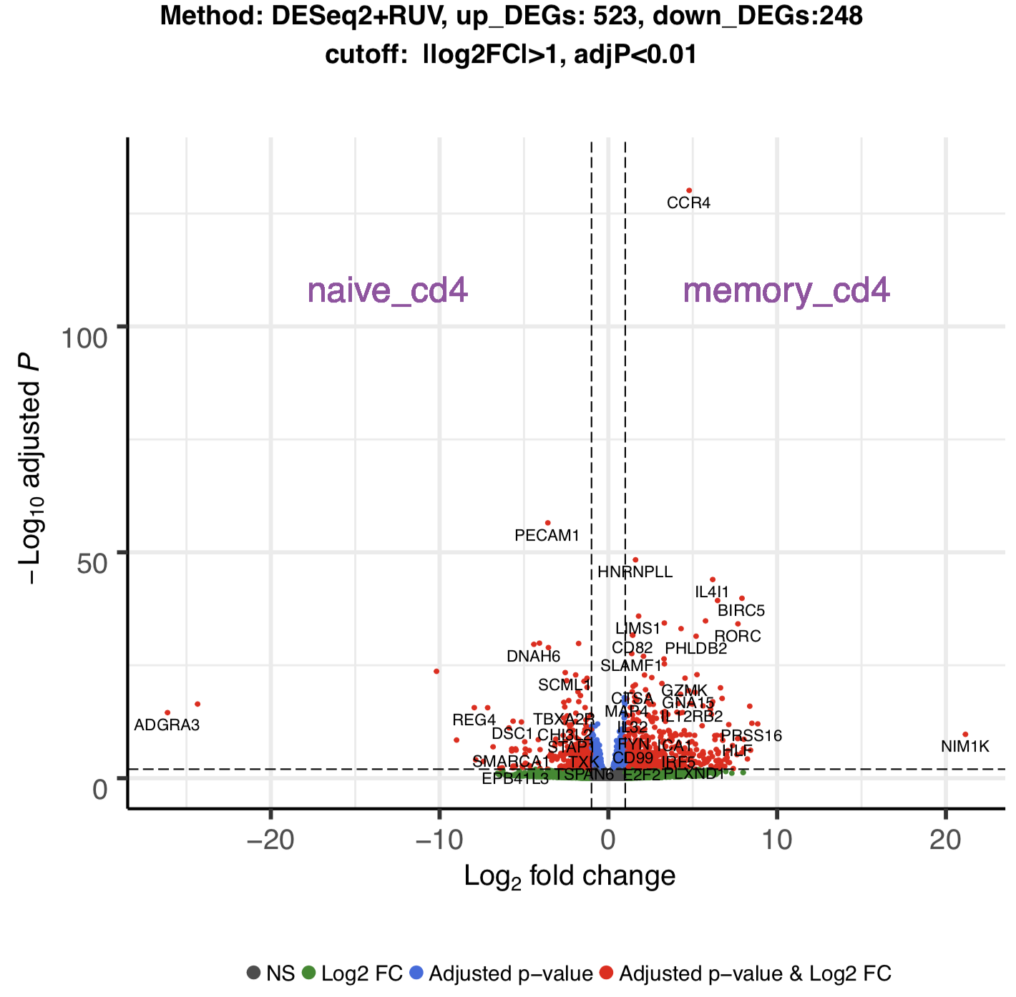
Naive_cd4 vs memory_cd4

Slide 32
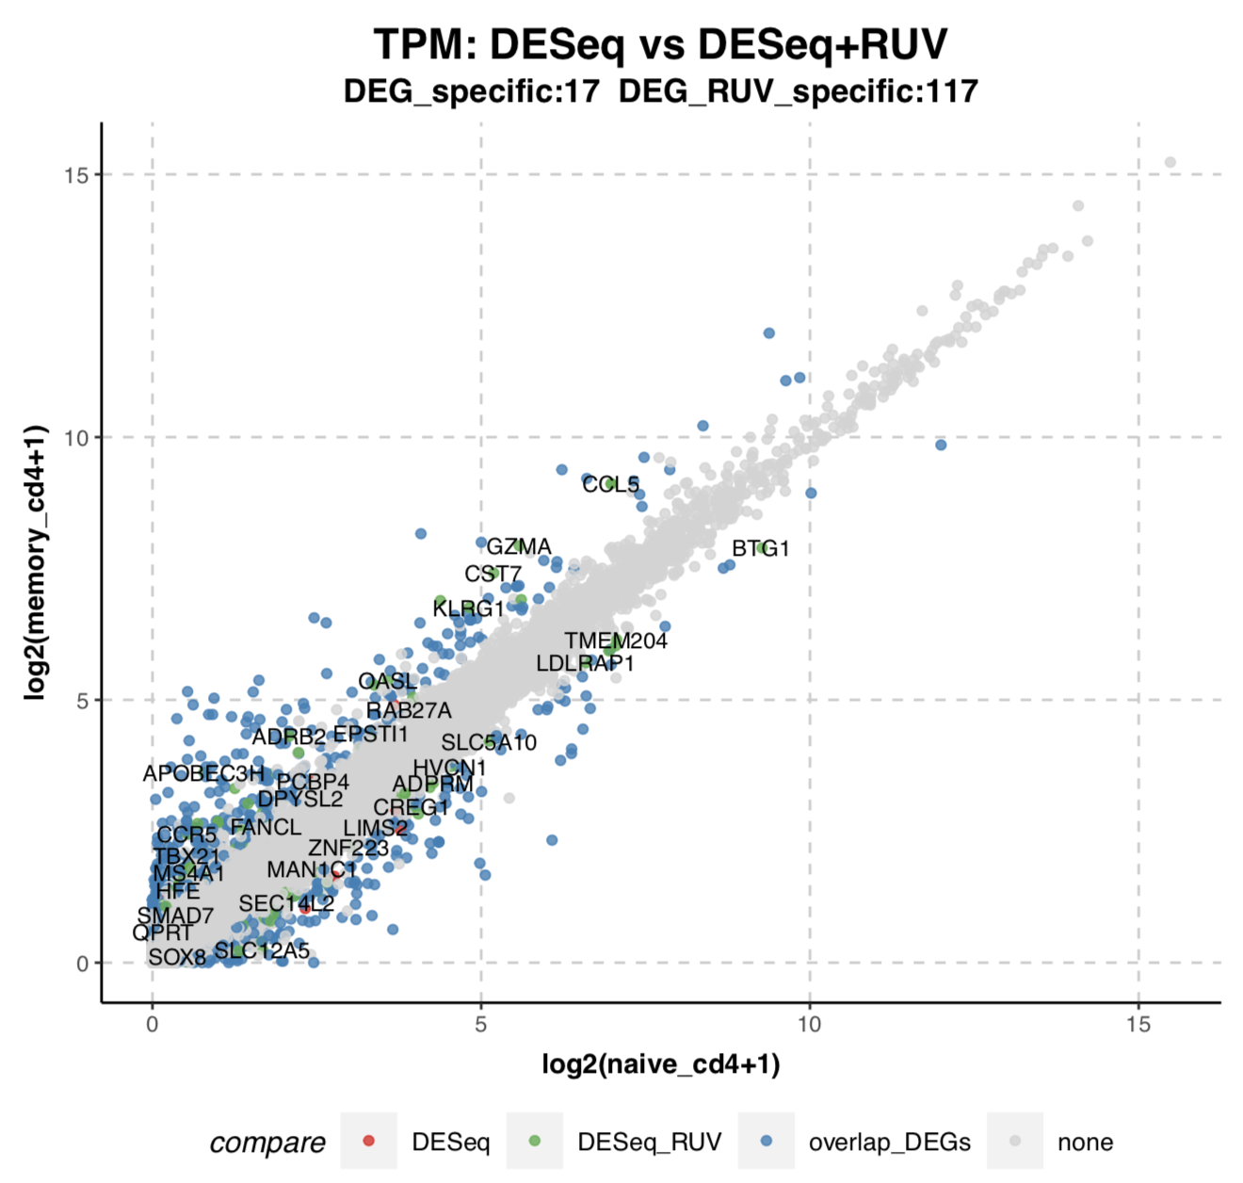
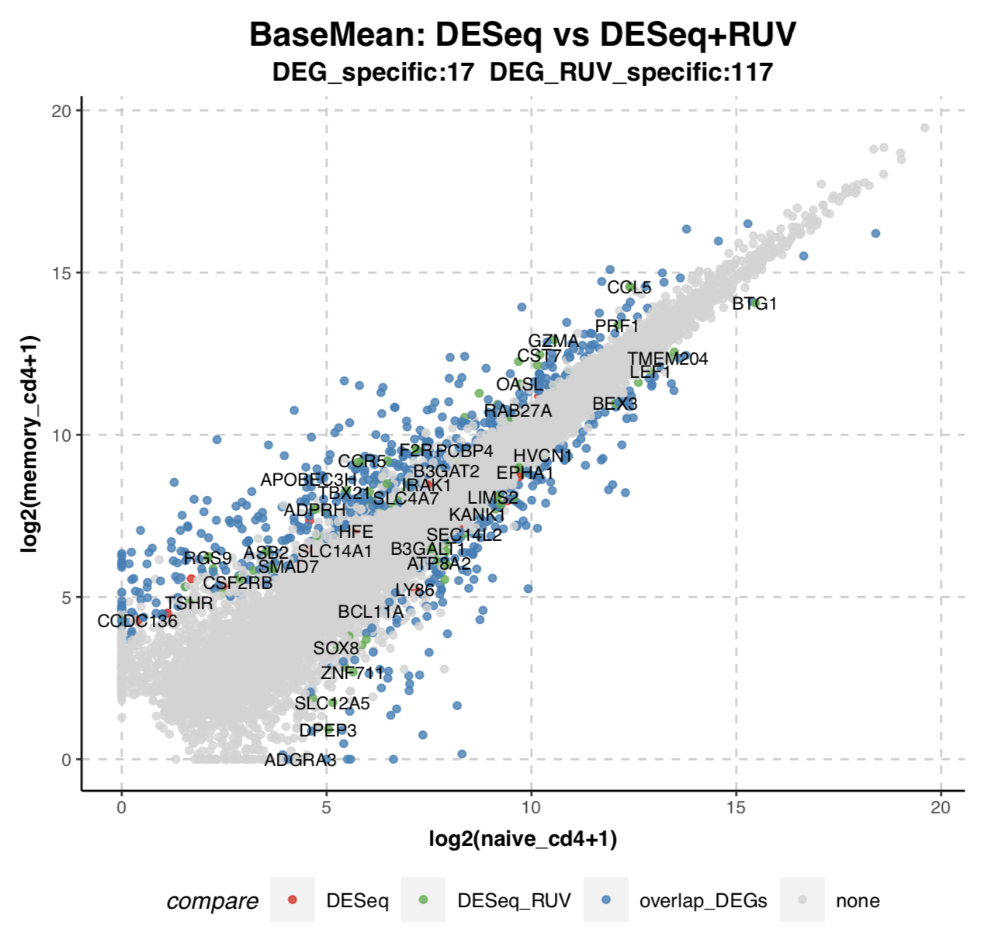
Naive_cd4 vs memory_cd4

Slide 33
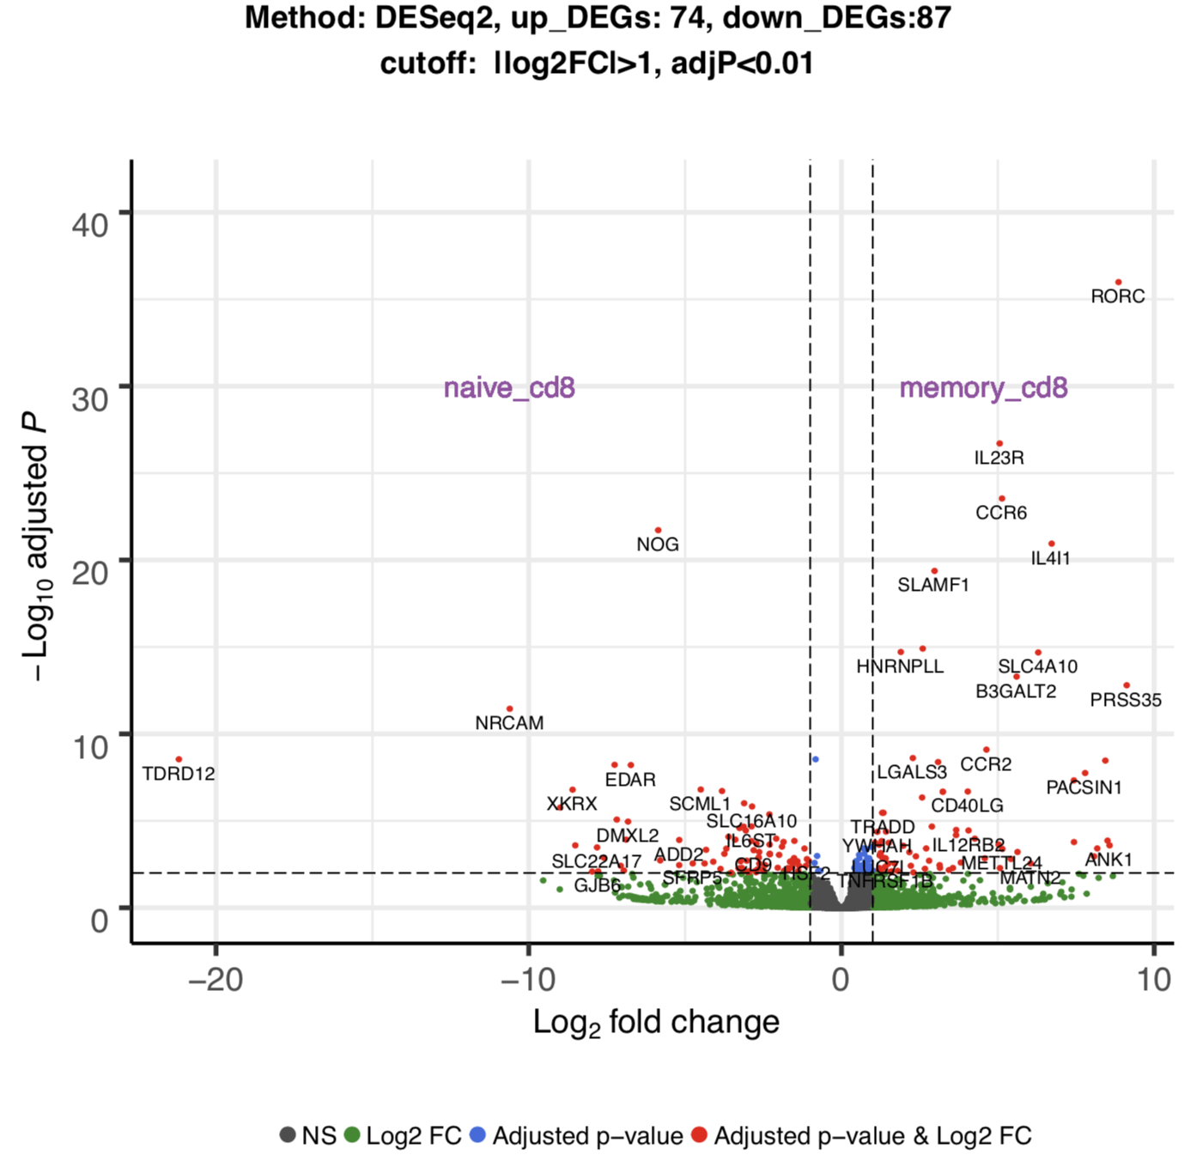
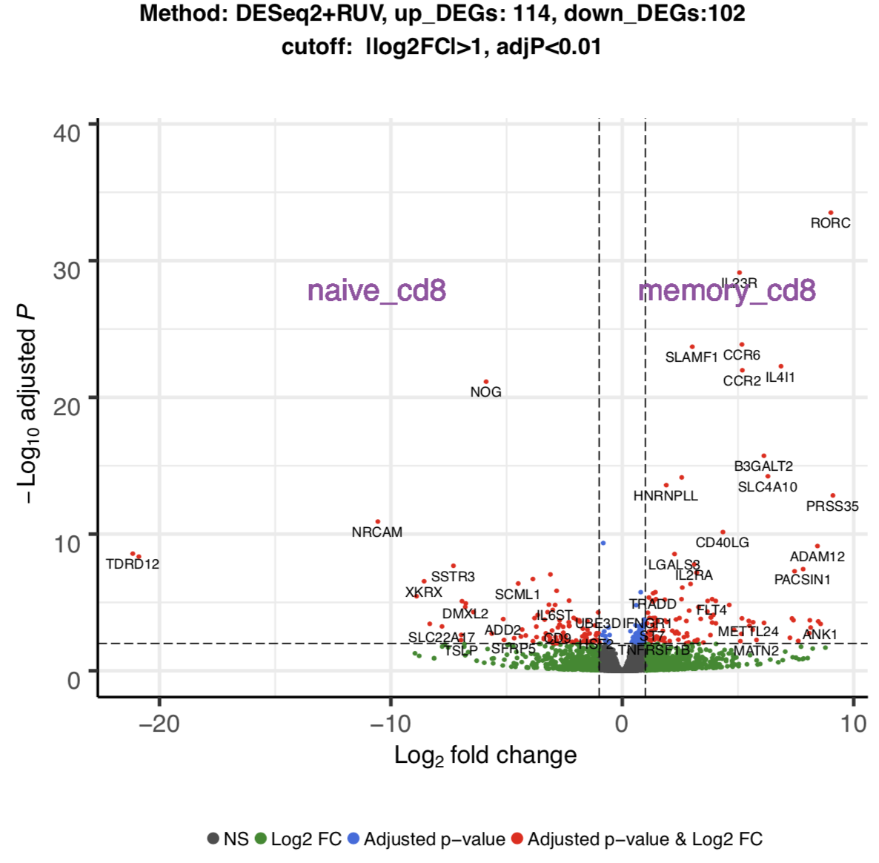
Naive_cd8 vs memory_cd8

Slide 34
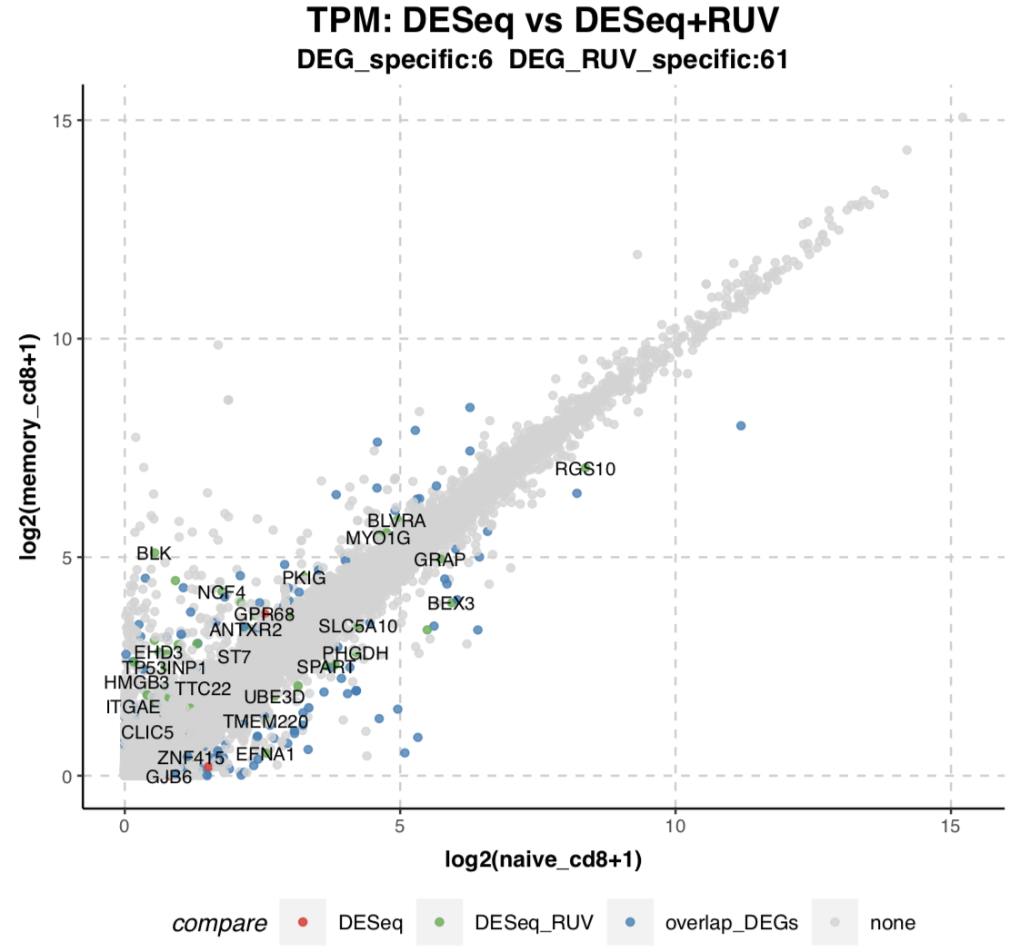
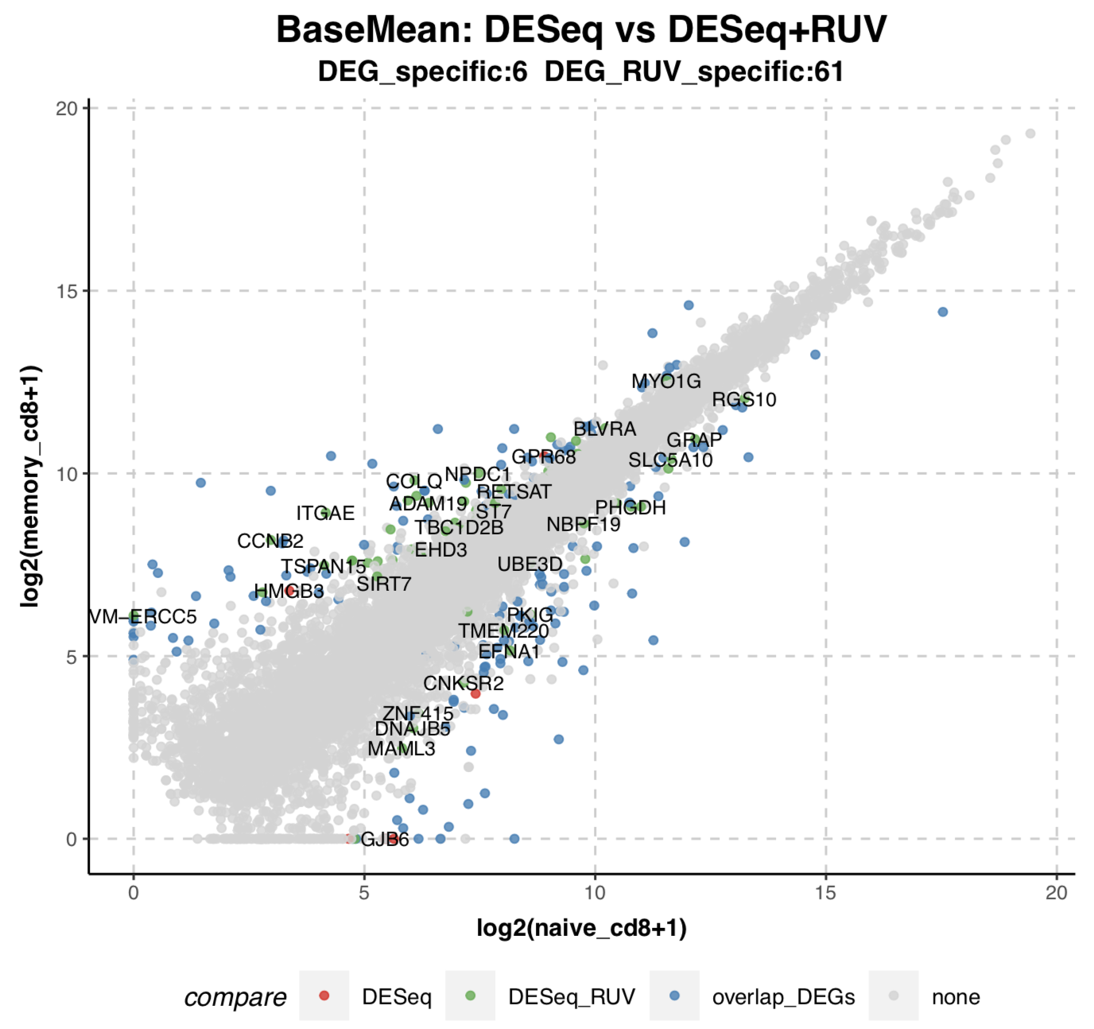
Naive_cd8 vs memory_cd8

Slide 35
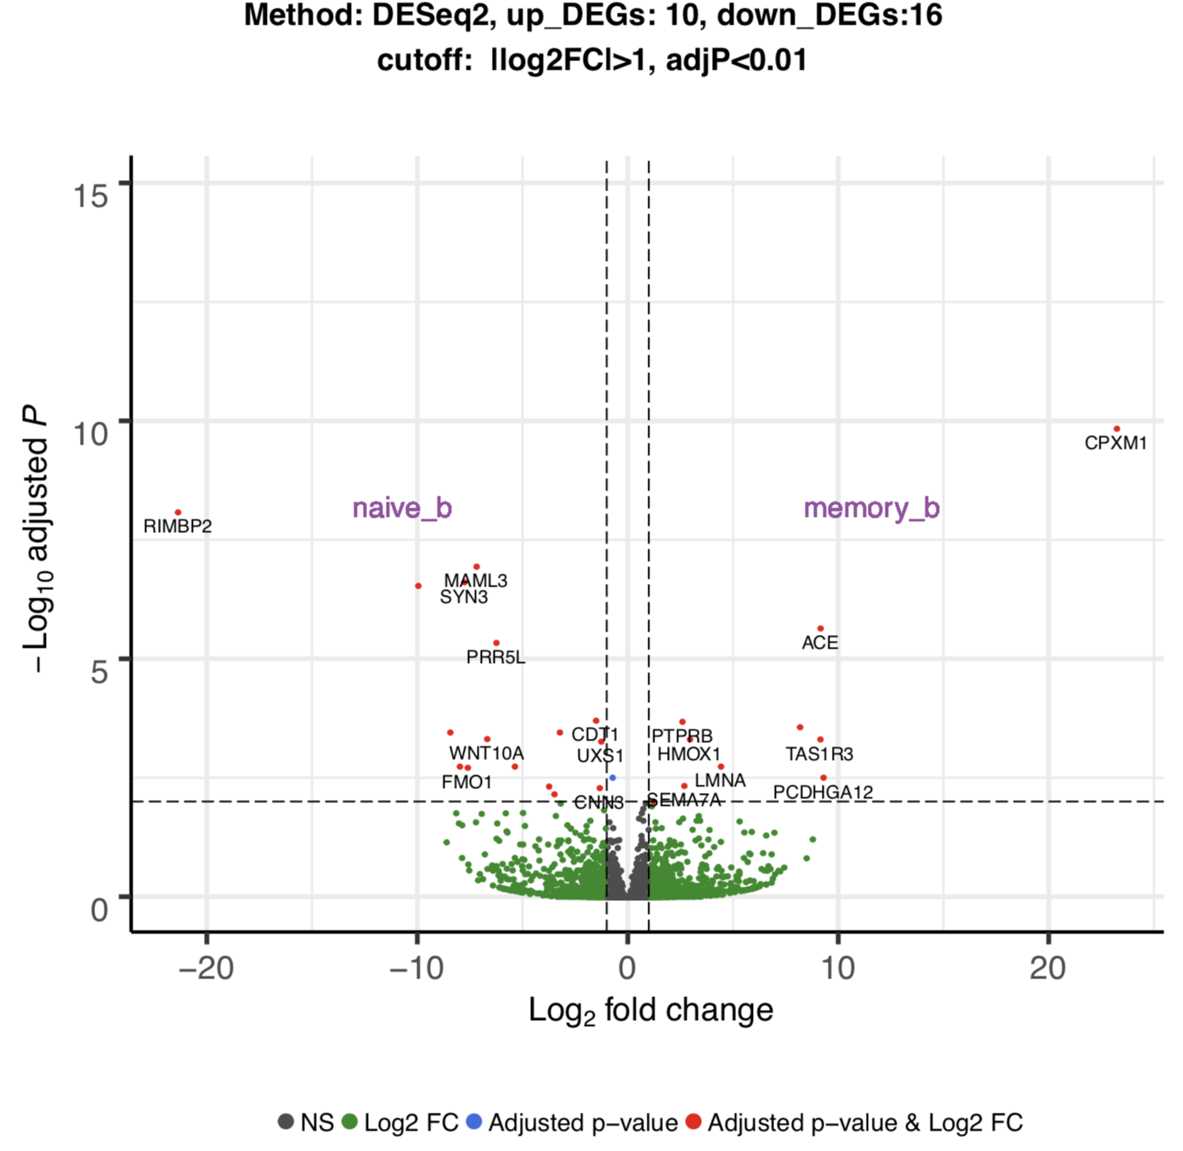
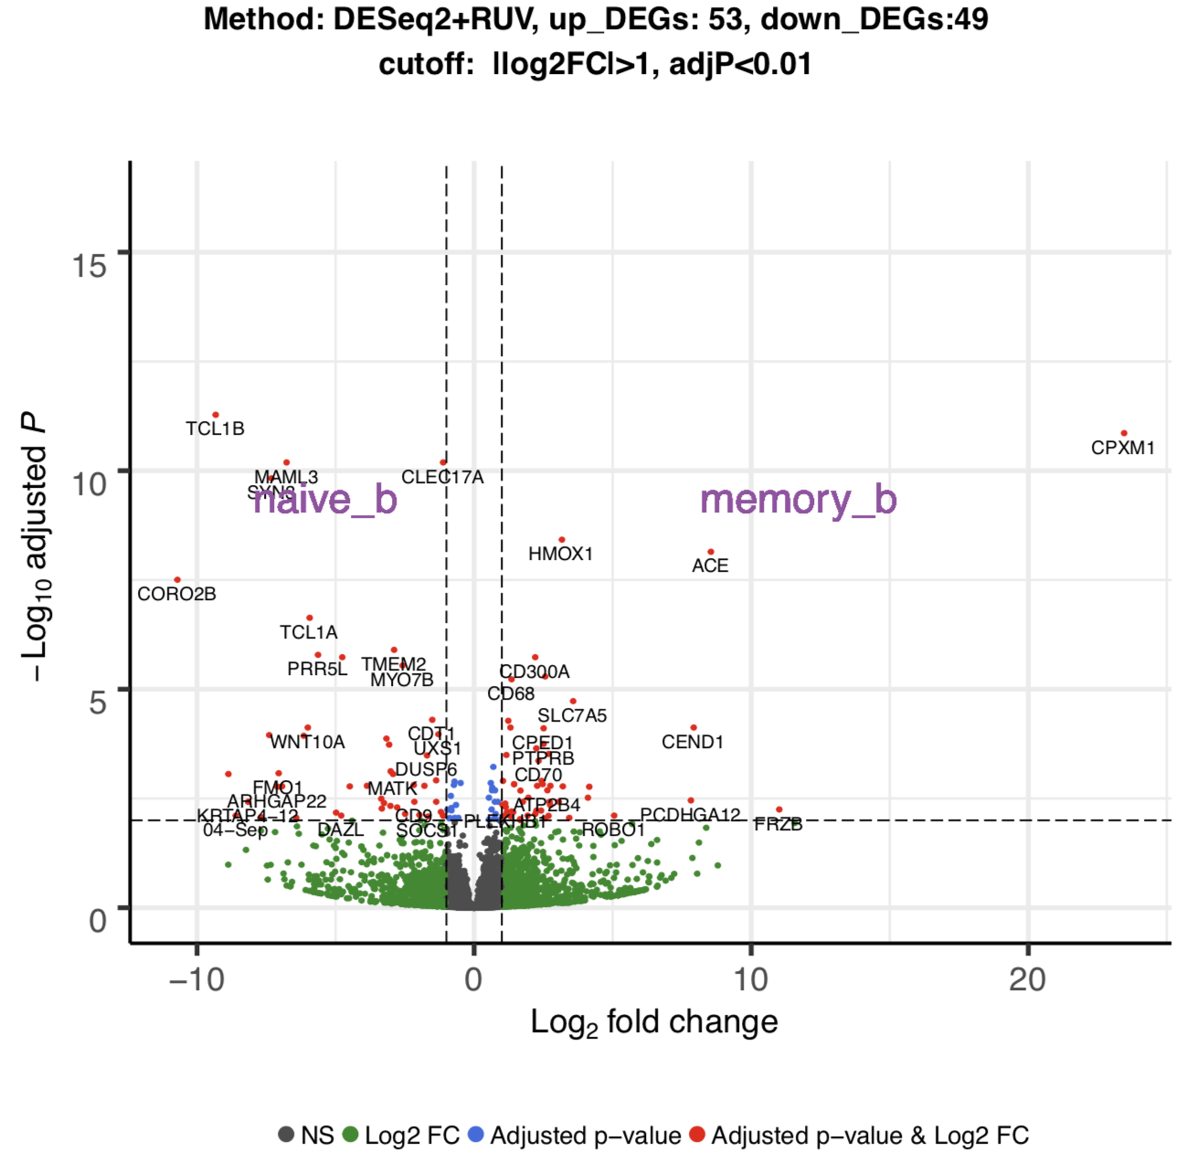
Naive_b vs memory_b

Slide 36
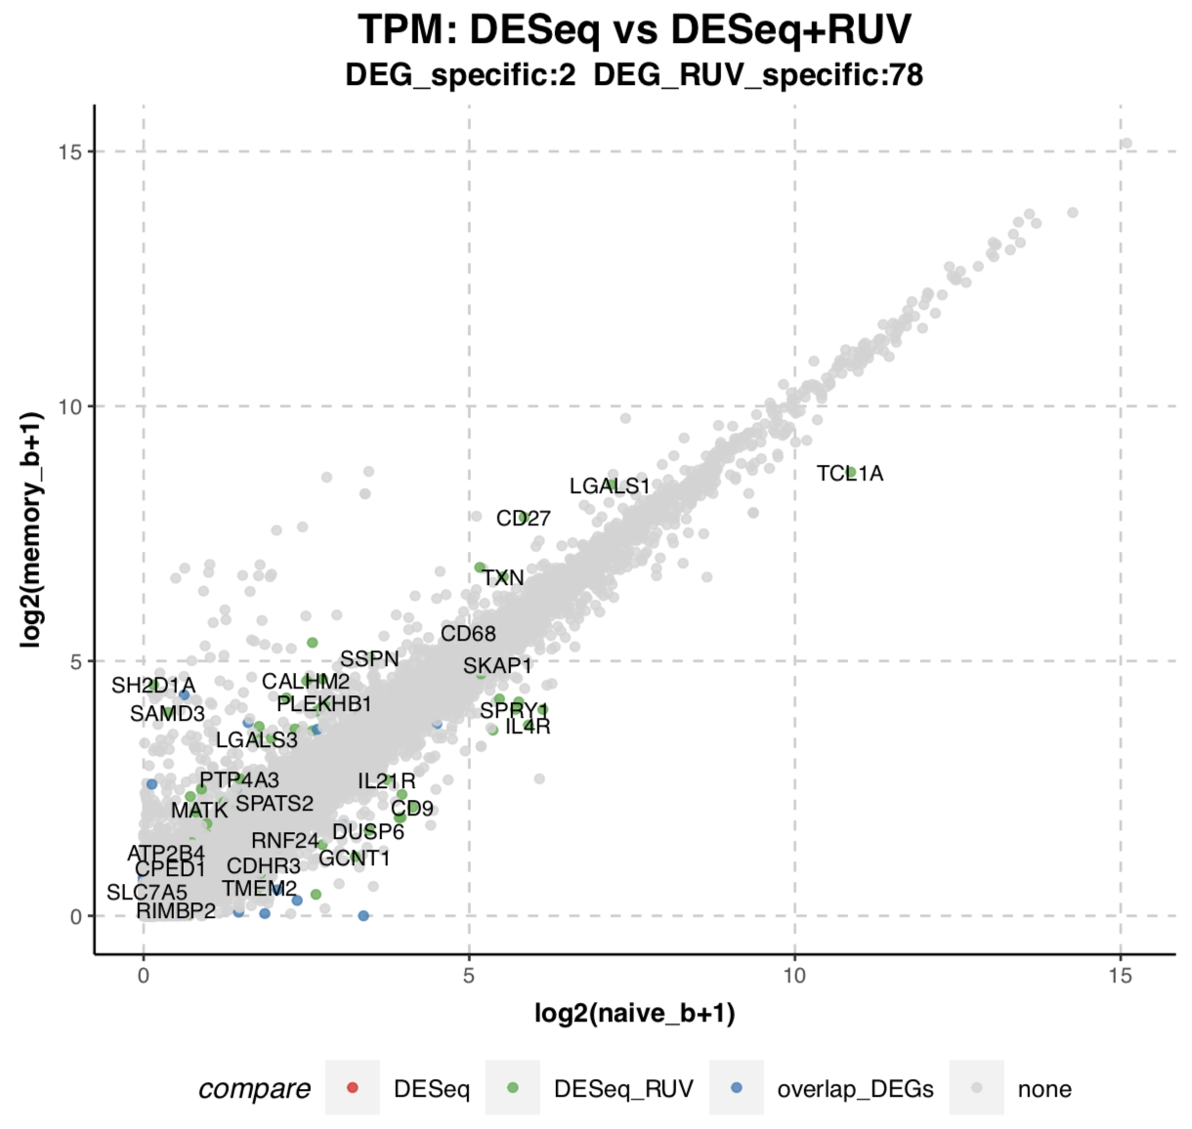
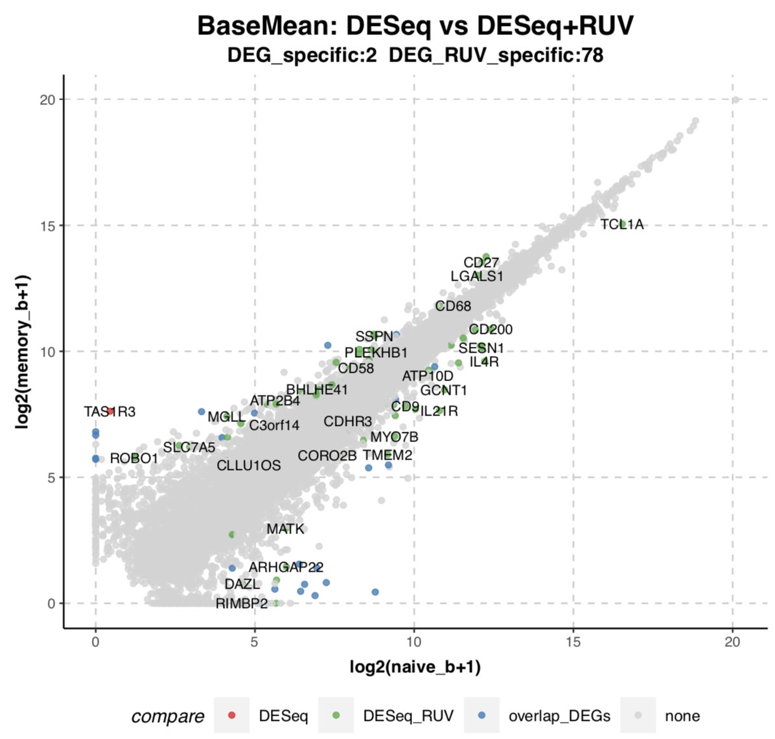
Naive_b vs memory_b

Slide 37
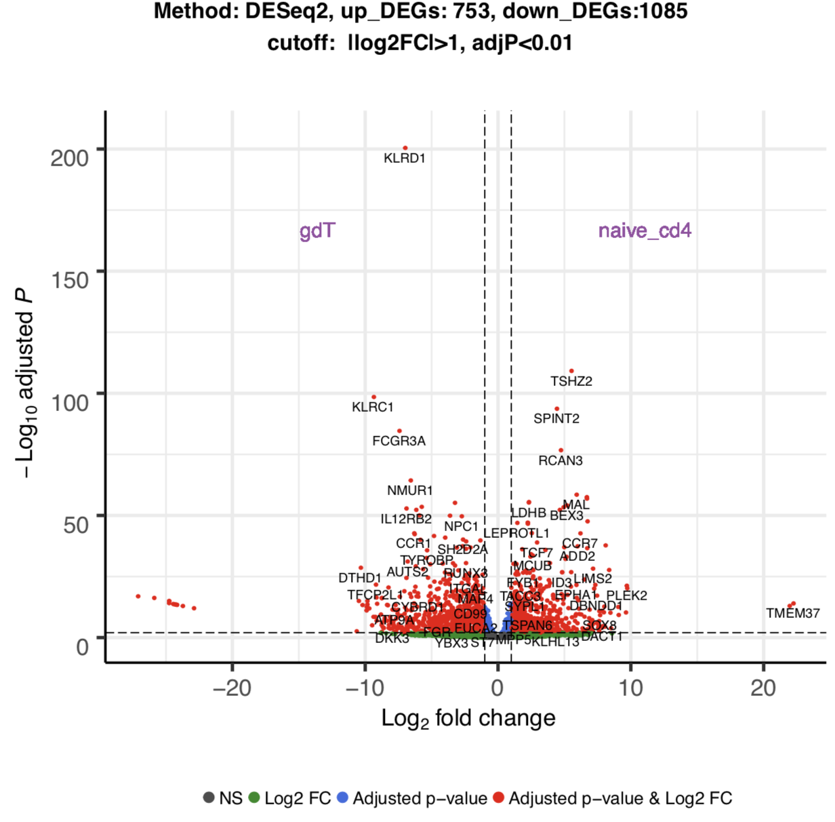
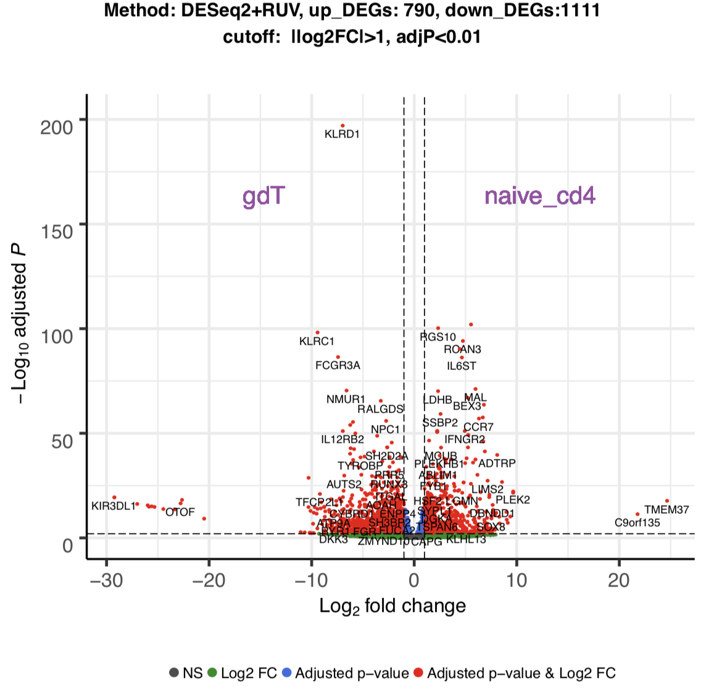
gdTCR vs Naive_cd4

Slide 38
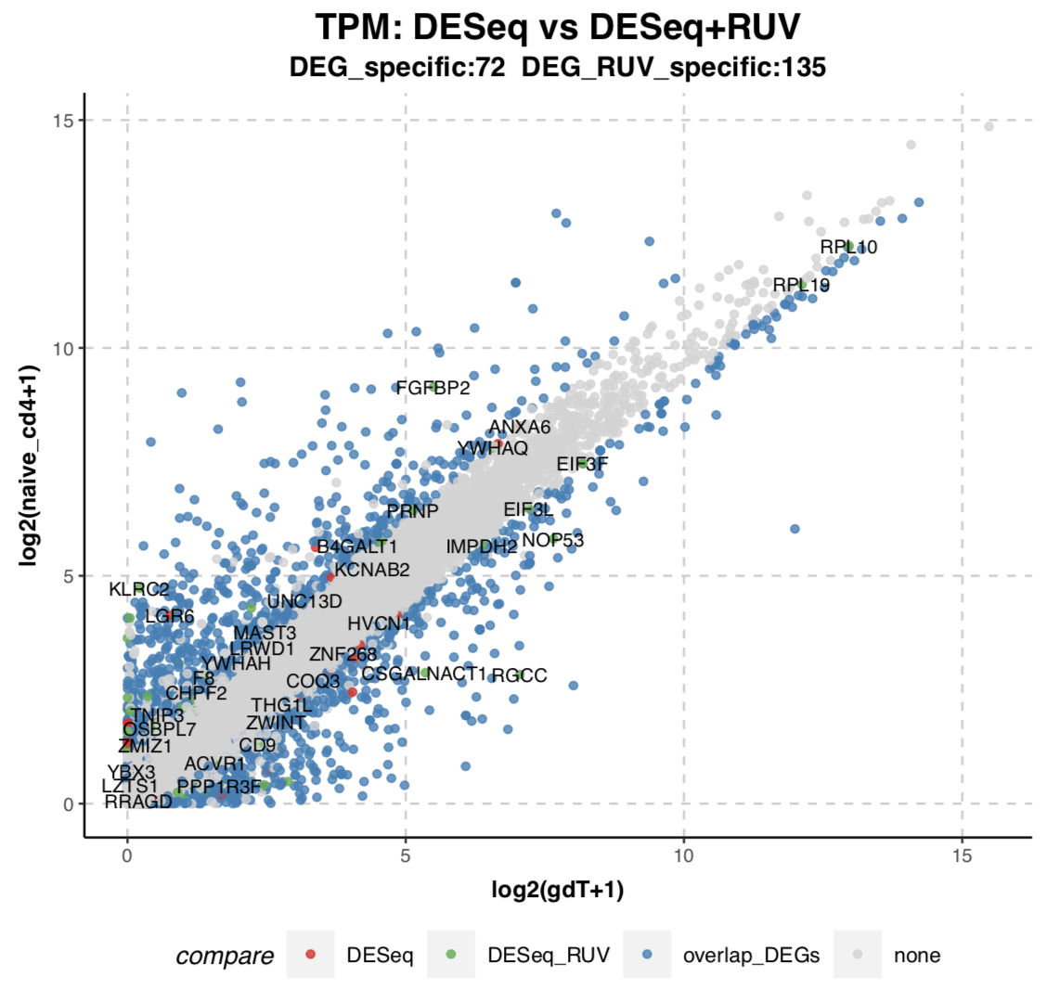

gdTCR vs Naive_cd4

Slide 39


gdTCR vs memory_cd4

Slide 40


gdTCR vs memory_cd4

Slide 41


gdTCR vs Naive_cd8

Slide 42


gdTCR vs Naive_cd8

Slide 43


gdTCR vs memory_cd8

Slide 44


gdTCR vs memory_cd8

Slide 45


plasmacytoid DC vs myeloid DC

Slide 46


plasmacytoid DC vs myeloid DC

Slide 47


Non-classical monocytes vs Classical monocytes

Slide 48


Non-classical monocytes vs Classical monocytes

Slide 49


Non-classical monocytes vs Intermediate monocytes

Slide 50


Non-classical monocytes vs Intermediate monocytes

Slide 51


Intermediate monocytes vs Classical monocytes

Slide 52


Intermediate monocytes vs Classical monocytes

Slide 53


NK-cells vs Naive CD8 T-cells

Slide 54


NK-cells vs Naive CD8 T-cells

Slide 55


NK-cells vs Memory CD8 T-cells

Slide 56


NK-cells vs Memory CD8 T-cells

Slide 57


NK-cells vs Classical monocytes

Slide 58


NK-cells vs Classical monocytes

Slide 59


NK-cells vs Intermediate monocytes

Slide 60


NK-cells vs Intermediate monocytes

Slide 61


NK-cells vs Non-classical monocytes

Slide 62


NK-cells vs Non-classical monocytes

Slide 63


tRegs vs Memory CD4 T-cells

Slide 64


tRegs vs Memory CD4 T-cells

Slide 65


tRegs vs naive CD4 T-cells

Slide 66


tRegs vs naive CD4 T-cells

Slide 67
Figure 4. CyTOF (Petter)
???
D. Validation of new CD ,marker in whole blood ???

Slide 68
Figure 5. Proteins in blood
A. MS (Jochen)
B- Olink (linn)
C. Other protein assays from literature (Björn F)

